Slide 1
“Above all, be true to yourself, and if you cannot put your heart in it, take yourself out of it.”

Slide 2
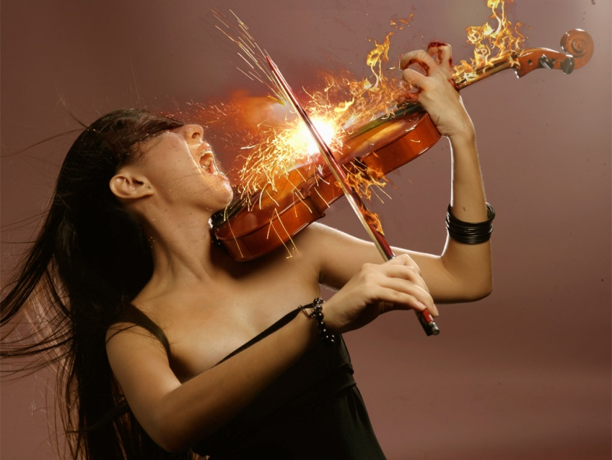
I. What Are Your Passions?
List 6 Things that you are passionate about.
(I.e. Singing, dancing, cooking, Helping people, Music, Sports…)
Please do not include things like “Family” or “Girlfriend”, “Love”
Try to think of things that you are passionate about doing.

Slide 3
II. What are your plans?
What are your plans for the next few years?
Are you attending college?
If so where and what major are you planning on doing.
If not, explain what you are planning to do with your life.

Slide 4
III. 15 years from now?
What do you think your job will be in 15 years?
Please be realistic.
Do not say you will be a neurobiologist when you got a “C” in Bio or physiology. Don’t say you will be a professional dancer when you can’t snap your fingers and walk at the same time. Don’t say you will be an NBA player when you are 5 foot nothing and can’t shot free throws.

Slide 5
IV. Look at your list.
Examine your lists for I – III.
Is there a common link between all three? Do any of them connect? Do any of your passions relate to what you expect your will be in the future?

Slide 6
Livelihood versus a Job
What is a job?
How much do we work in a year?
Total Hours Per year: 8760 hrs
Sleep: 2920 hrs
Getting ready and commute: 806 hrs
Work: 2,152 hrs
Free time: 2882 hrs***
This includes the hours you need to use for chores, errands, etc…

Slide 7
How Many Hours will we work?
94,688 hrs

