Slide 1
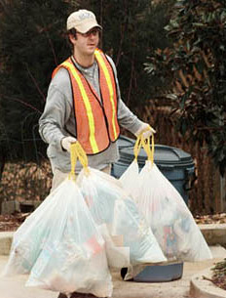
Chapter 3
The Dignity of Work

Slide 2
Author
Sanitation
Police officer
Banker
Lawyer
Custodian
Nurse
Governor
Construction Worker
Chemist
High School Teacher
Dentist
Psychologist
College Professor
Doctor

Slide 3
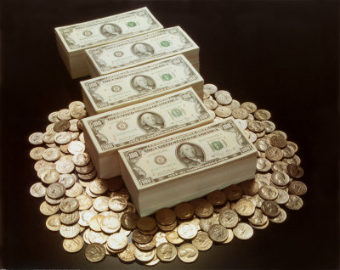
Why Work?
1. To Earn money
To meet basic needs
2. To fulfill ambitions
Desire for personal achievement

Slide 4
Why Work (continued…)
3. To develop a sense of identity
Work allows us to find out about ourselves
Work allows us to grow and find out who we truly are.
4. To do what one loves
People who love what they do tend to bring enthusiasm in their work.
People who enjoy their work are renewed by their work, not bring them down
“Happiness is being paid to do what you would do anyway

Slide 5
Why Work (continued…)
5. To build a better world
Are we just working to support ourselves and our families?
Should we be doing things to help those around us?
6. To Answer a call
Answering a vocation.
A call that comes from within ourselves that we sometimes try to ignore.

Slide 6
Quick Assessment
Do you like working with things, animals, people, or data?
Do you like working with a big group of people or a small group?
Do you like working with the same people or do you want change?
Do you like working with kids or adults?
Do you like the work environment to change or remain the same?

Slide 7
Quick Assessment
Do you like the idea of working for yourself or do you mind working for someone else?
Do you like doing something active?
Do you like working indoors or outdoors?
What is the most important thing in life?

Slide 8
10 most satisfying jobs
Clergy—87 percent
Firefighters—80 percent
Physical therapists—78 percent
Authors—74 percent
Artist- 73 percent
Special education teachers—70 percent
Teachers—69 percent
Education administrators—68 percent
Painters and sculptors—67 percent
Psychologists—67 percent
Office supervisors—61 percent

Slide 9
10 Highest paying Jobs
1. Surgeons $219,770
2. Anesthesiologists $211,750
3. Oral & Maxillofacial Surgeons $210,710
4. Orthodontists $206,190
5. Obstetricians & Gynecologists $204,470
6. Internists – General $183,990
7. Physicians & Surgeons, Other $173,860
8. Family & General Practitioners $168,550
9. Chief Executives $167,280
10. Psychiatrists $163,660

Slide 10
Toward a Life’s work
Assess yourself
Figure out your:
Interests
Skills
Personality
Talk to people
Find out if they are happy and why.
Volunteer & Try out careers
Get first hand experience from your chosen career before deciding.

Slide 11
Develop Your Skills
Career content skills
Transferable Life Skills

Slide 12
Insight into Work
“What are you doing?” a passerby asks.
“Making little rocks out of big ones” says the first worker
“Earning a living” answers the second.
“Building a Cathedral” says the third.

