Slide 1
Edmodo.com Codes
2nd Period: GAEDZI
4th Period: YQMUES
6th Period: T5MBOC

Slide 2
Chapter 3 & 4 test
Consider the phrase, “Money can buy the good life”. Defend this phrase as both true and false. Come up with an example for each case.
What is the Christian view regarding work? Identify what your dream job is and explain how that job matches up with the Christian view.
Saint Paul told the Corinthians to “achieve a fair balance between abundance and need”. What is Saint Paul asking of us. Give examples from the book as to why this would be hard for us to follow.

Slide 3
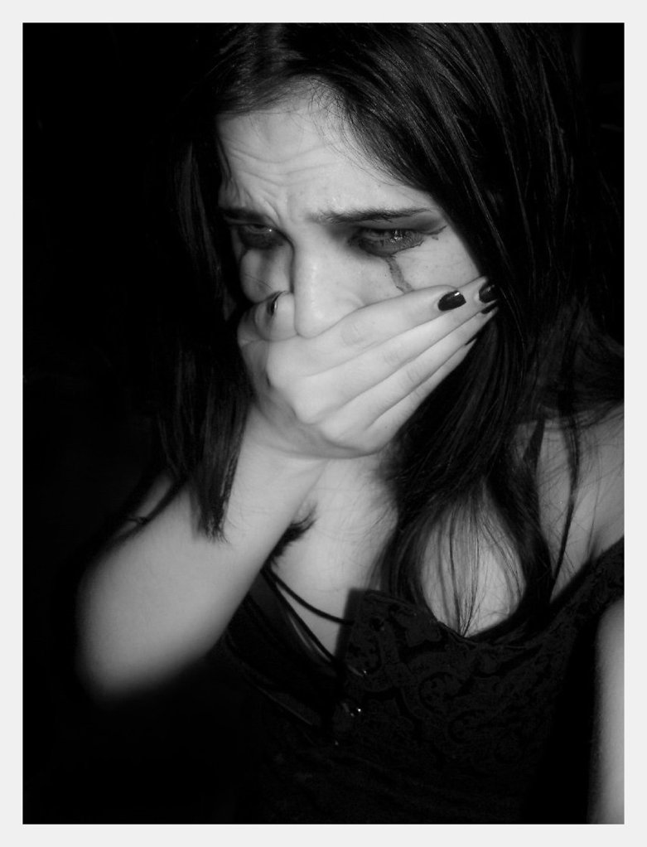
Chapter 5
Suffering and Healing

Slide 4
The many Faces of Suffering
Being Human
Certain losses will occur in life
Big and small
Even in times of Joy there will be a sense of loss
Graduation
Marriage
Having a baby

Slide 5
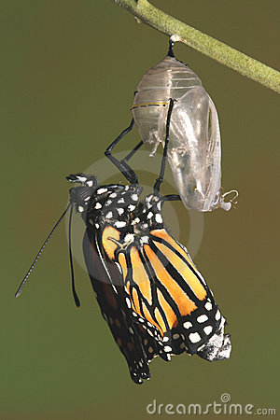
Necessary Losses
We must realize that these losses are Necessary
Want and need are two different things.
We need to go through certain losses to grow
Even out of the worst loss, beauty can still be found.

Slide 6
When suffering seems senseless
Sometimes we experience such a great loss such as a death.
We often feel like it was unnecessary, like it should not have happened.
Suffering
Disintegration
Like we are being torn apart
Like are not whole anymore
Like everything is falling apart
We often ask the biggest question:

