Slide 1
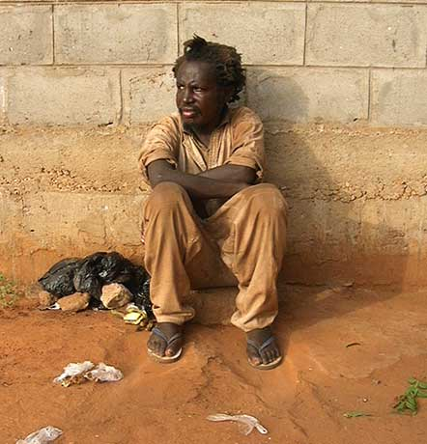
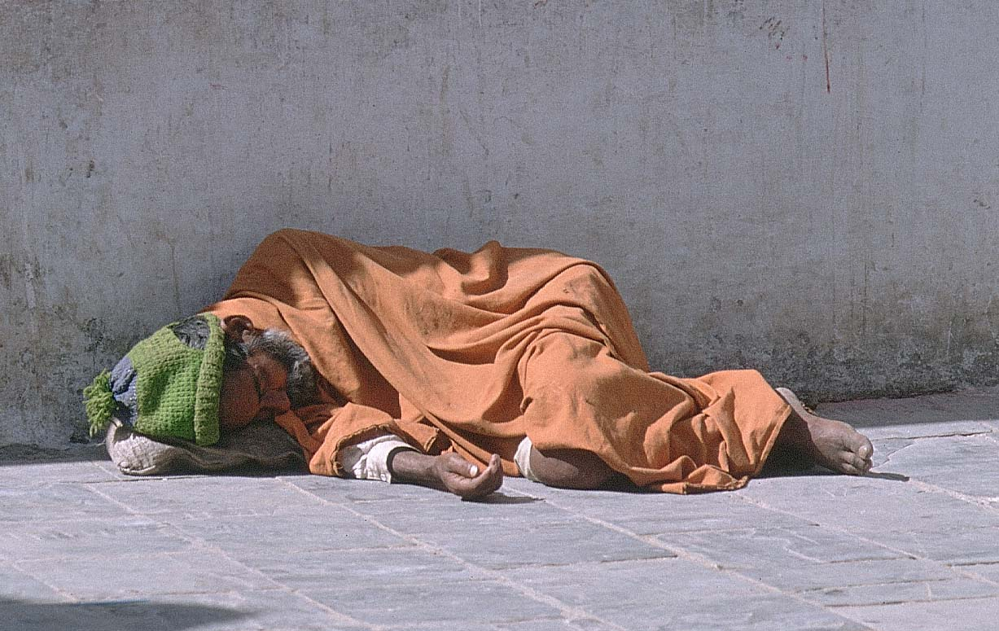
Suffering and Healing
Part 2

Slide 2
2 Sources of Suffering
Natural Causes
For everything there is a season, and a times for every matter under heaven
(Ecclesiastes 3:1)
2 reasons for natural causes
Nature
Earthquakes, Tsunamis, Blizzards
Human Nature
Life Cycle
Being Born growing up, dying

Slide 3
2 Sources of Suffering
Human Choice
Suffering lies in the Human heart
Moral Choice
Domestic Violence, child abuse, rape, bullying, murder, genocide
These are the results of Human decisions
Greed
Hardness of the Heart
Apathy

Slide 4
Why?
“Why, O Lord, do you stand so far off? Why do yoou hide yourself in times of trouble?”
“Why do you look on the treacherous, when the wicked swallow those more righteous than they?”
The Shoah, or the Holocaust, is a perfect example.
Open your books to page 91.

Slide 5
Does God want me to suffer?
God tests us with suffering
God allows it because it makes us stronger
God allows it because we won’t know good unless we experience the bad
God is like a mother to us:
“Can a woman forget her nursing child, or show no compassions for the child of her womb? Even these may forget, yet I will never forget you.”

Slide 6
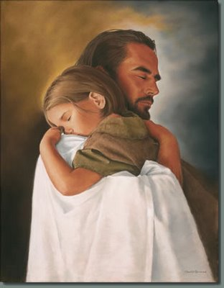
Loving, not controlling
God does not control Moral Choices
God cannot stop us without taking away the freedom that makes us Human.
God does not control the laws of nature.
The laws of nature do not make exceptions for “nice people.”

Slide 7
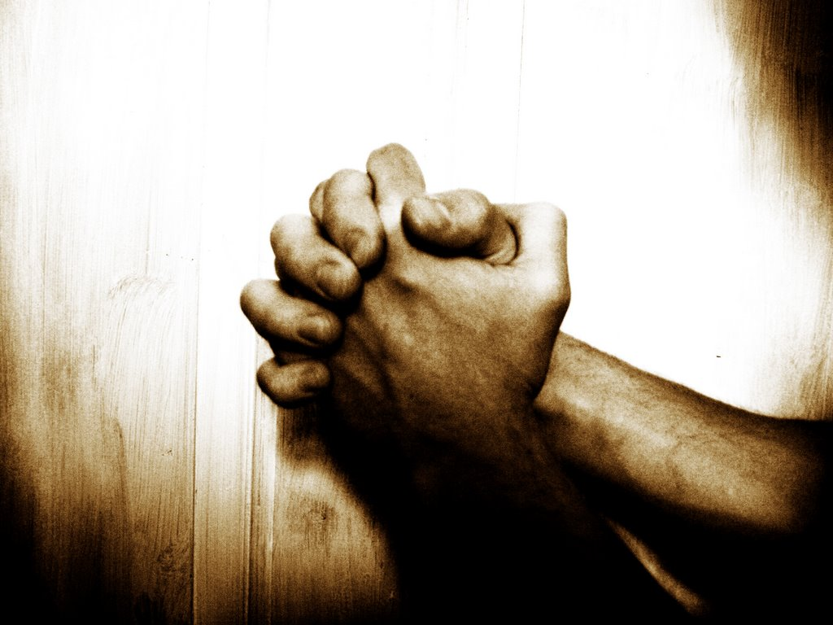
Change our paradigm
Why ask, “why do we suffer?”
We cannot control what happens in life.
God will not interfere with our decisions.
We should ask 2 questions
“What can we do prevent it?”
Ie. Abuse, bullying
“What can we do with the pain once it comes?”

Slide 8
Classwork
Read Pgs. 96 – 97
Answer the three Review questions on pg. 97

