Slide 1
Suffering and Healing
Part 3

Slide 2
Transforming the Pain
The question we should b asking is not “why?”
We should be asking the question of “how?” How should we suffer?

Slide 3
Steps on how to deal with suffering.
1. Accepting Risk
If we choose life we have to accept the possibility of pain.
If we want joy we have to be open to pain
If we want Love we have to be open to loss

Slide 4
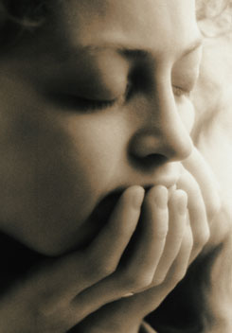
Steps on how to deal with suffering.
2. Healthy Grieving
The natural reaction to pain and suffering is Grief.
Feelings of despair, hopelessness, anger, and depression
The natural reaction to grief is:
Deny it
Hide it
Healthy grieving includes
Acknowledge the loss
Express feelings
Take action and try to move on

Slide 5
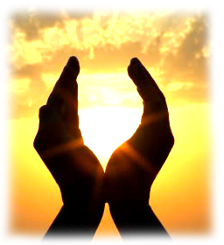
Steps on how to deal with suffering.
3. Embrace the Goodness
Find the good things that might be around us that we do not see when we are in pain.
4. Become Healers ourselves

Slide 6
The most important thing
Redemption
Being open to the possibility of being healed.

