Slide 2
WESLEY CHAPEL — No matter how hot it gets on the sauna of a practice field at Wesley Chapel High, Ahmed Elshaer will not drink.
No matter how faint the senior offensive lineman feels, he will not eat. Now matter how tough things get for the 16-year-old Muslim, he will not cave.

Slide 3
Elshaer is fasting from all food and drink from sunup to sundown for Ramadan, the Muslim holy month that lasts all of August.
That means no water or sports drinks during the opening weeks of high school football practice — even as the heat index is expected to reach triple digits and concern about heatstroke is growing nationwide.
“If it’s my time, it’s my time,” Elshaer said. “If not, God watches over me.”

Slide 4
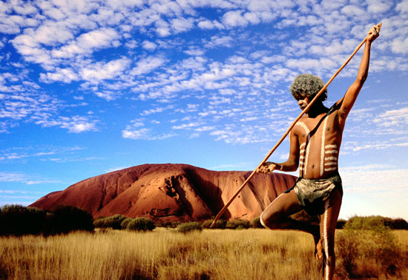
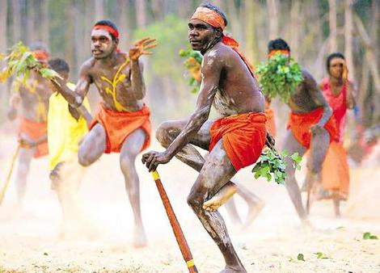
Primal Religious Traditions
Chapter 2

Slide 5
What are Primal Religions?
Since prehistoric times, groups throughout the world have been practicing their own unique form of Religion.
We call some of them primal
They come before modern religious traditions
Primal: The first, original state

Slide 6
Why study Primal religions?
Helps us understand Mythic aspect of Religion
Unlike modern religions, Primal religions have kept their mythic traditions.
These traditions help explain the essence of their philosophy
Religions find similarities with primal religions.
Hinduism, Judaism

Slide 7
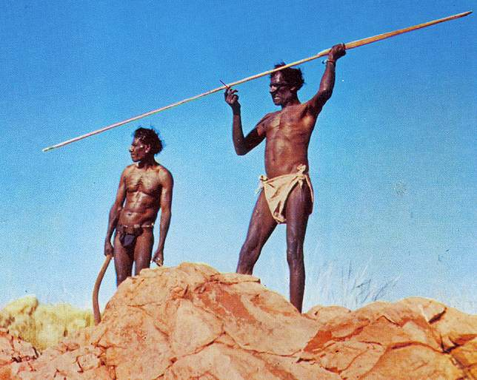
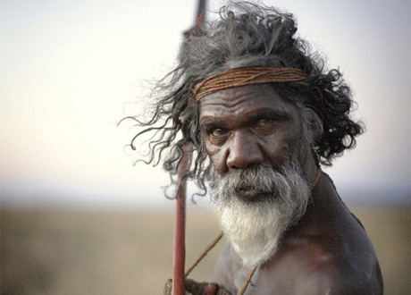
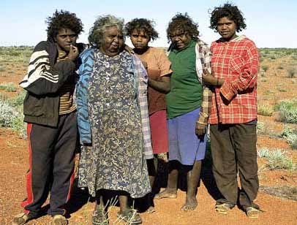
Australian Aborigines
Native people of Australia

Slide 8
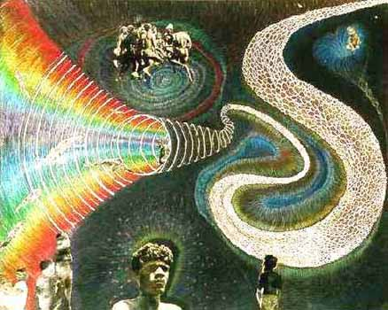
The dreaming
Mythic time when the “Ancestors” or ancestral beings , spiritual beings, roamed the earth.
Ancestors: gave shape to everything in the world, even the first human beings.
Organized each tribe and gave them language, culture, rules…

Slide 9
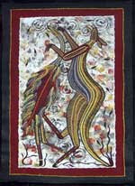
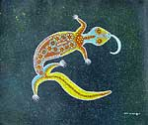
The Dreaming…
Bohra the Kangaroo and Dinewan the Emu: Light
Bangarra the Lizard: Water

Slide 10
The Dreaming…
The ancestors left symbols of their presence in the world.
Each of these sites are believed to contain sacred power.

Slide 11
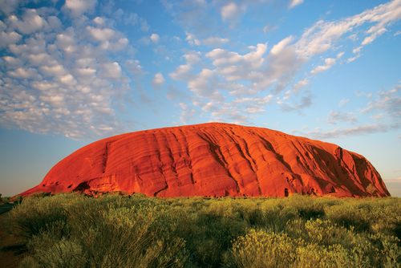
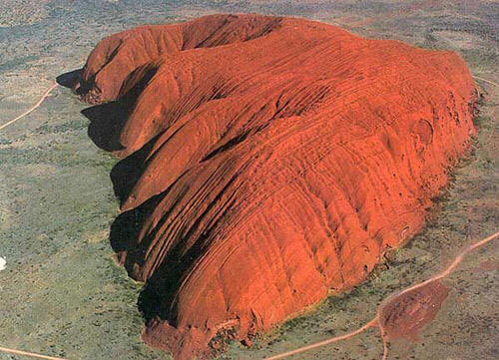
Sacred places
Uluru or also known as Ayers rock

Slide 12
Essence of the ancestors can be found…
Only selected individuals are allowed to visit these sacred spaces.
As a form of ritual they have to follow the path that the ancestors
This reenacts the mythic events of the dreaming.
“Mythic Geography”
Since all of the land contains sacred powers, nature places an important part of the religious tradition
Essential connection to the land

Slide 13
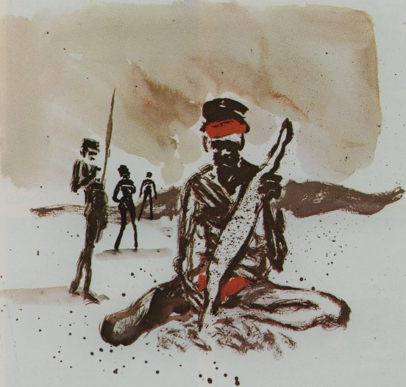
Essence within
Aborigines believe that the spiritual essence of the ancestors are also found within.
Each child is “Animated” by ancestors
Ritual draws the Ancestors spirit into the unborn child.
Once the child is born, the child has a connection with one of the Ancestors
This connection is symbolized by a “Totem”

Slide 14
Social Structure: Taboo
Taboo: certain people are forbidden from participating in certain rituals
Only certain individuals are allowed to participate because of the sacred nature involved.
I.e..
Sacred sites are only for men
Animating and childbirth are only for women
Restrictions are also about maturity.

Slide 15
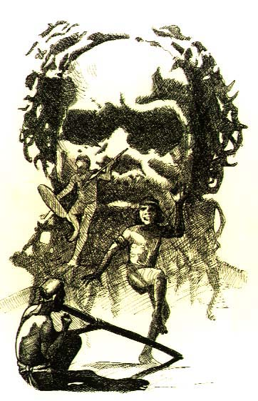
Initiation
Young people achieve Religious maturity through training and eventually initiation
It involves a “symbolic death”
Each tribe has different ceremonies
Takes place during puberty, from ages 9 -12
Rituals takes place for months.

Slide 16
Initiation for Women
Initiation for women were more private and less invasive
Exclusion from tribe
Body marking

Slide 17
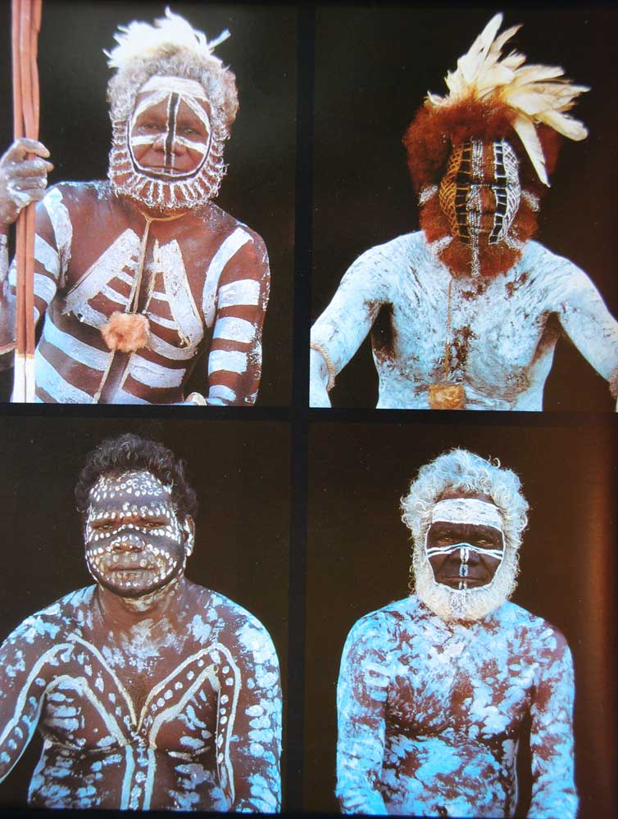
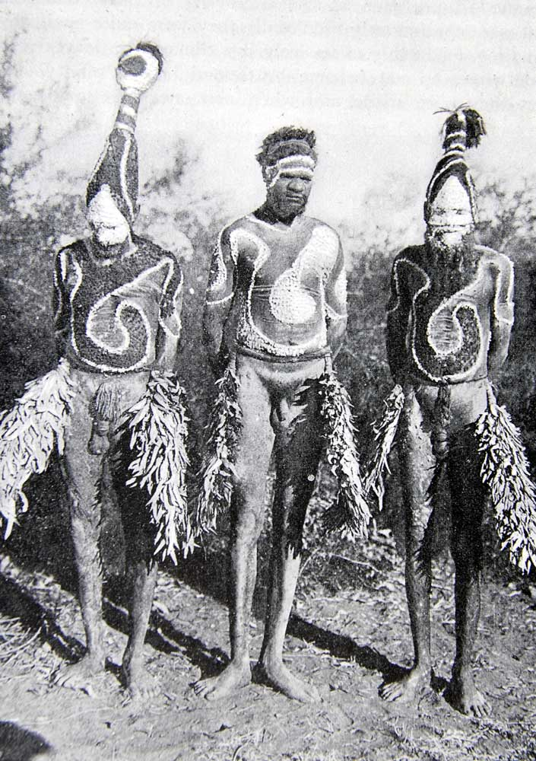
Body Painting Ceremony

Slide 18
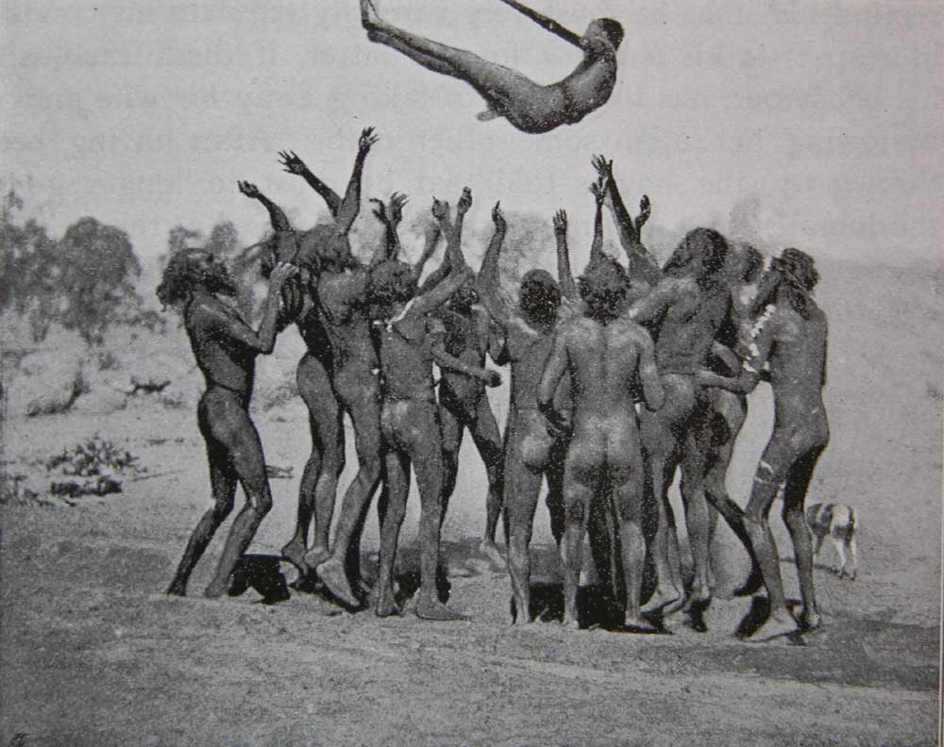
Alkira-Kiuma Ceremony
Tossing Ceremony of the Aranda Tribe

Slide 19
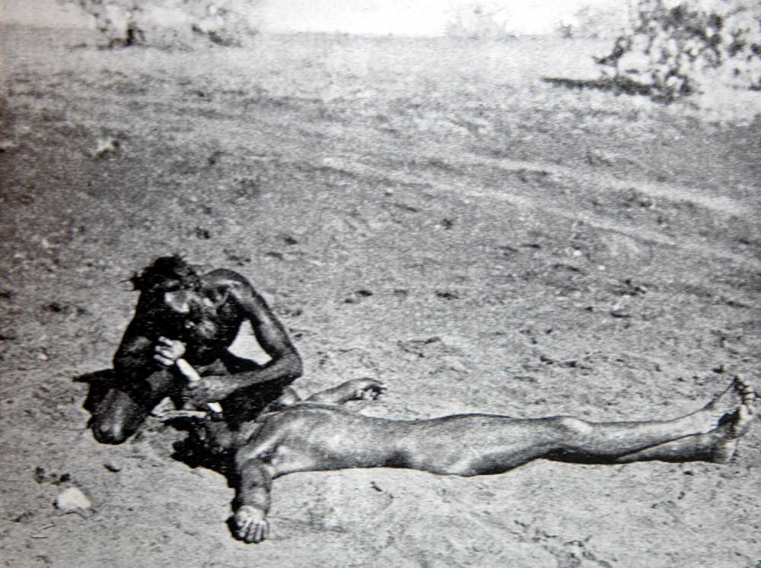
Tooth Knocking Ceremony

Slide 20
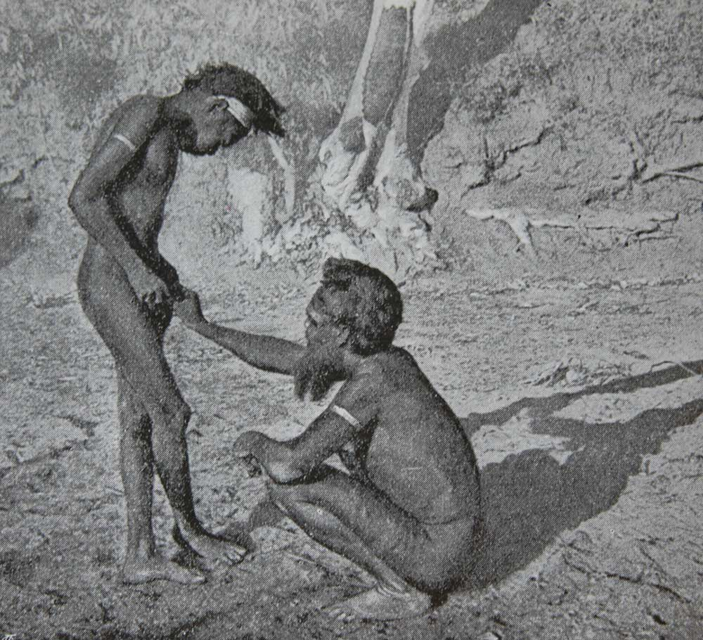
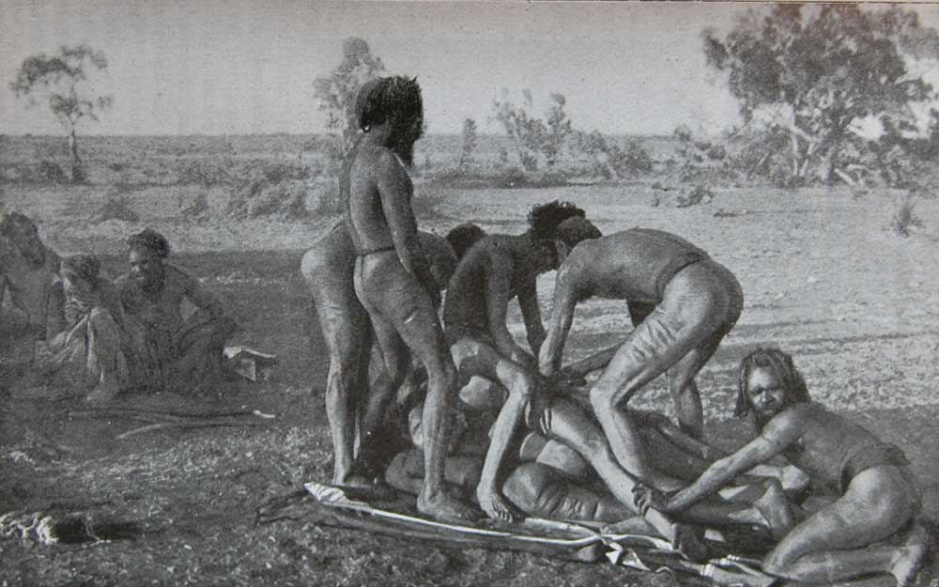
Circumcision and subincision

Slide 21
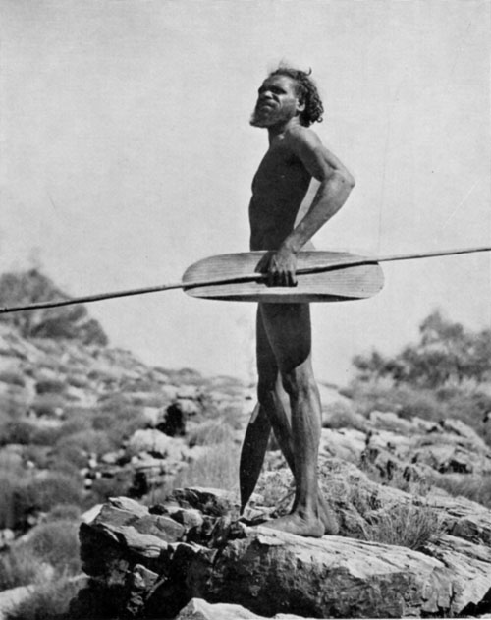
Wilyaru
Blood ritual
Connection to past relatives
Beating of the neck and back
Scars are important
Wandering alone for months

