Slide 1
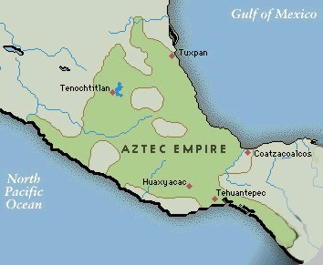
Aztec Empire
Located in central Mexico
Empire spanned
from the
14th -16th
centuries
Over 15 million people

Slide 2
A Brief Background
The Aztecs referred to themselves as Mexica
Huitzilopochtli, told them to settle on the site where they witnessed an eagle on a cactus devouring a serpent.
They named that land Tenochtitlan, present day Mexico City

Slide 3
A Brief Background
Practiced a syncretistic religion
Combined beliefs and practices of conquered people into one religion

Slide 4
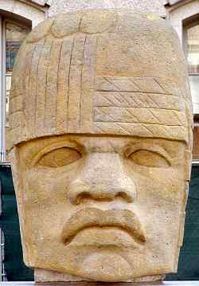
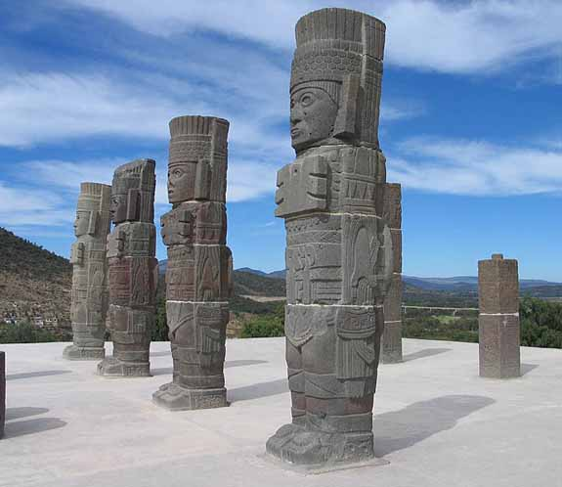
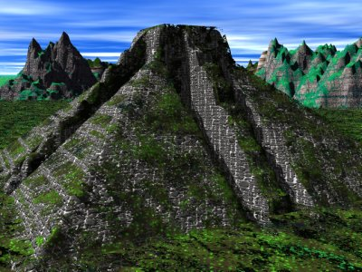
Different Civilizations
Olmec
Maya
Toltec
Aztec

Slide 5
Quetzalcoatl (Feathered Serpent)
Toltec God used by the Aztecs. Believed to have created the world.
Believed to have brought a Golden Age of civilization to Mesoamerica.
“Truly with him it began… truly from him it flowed out… From Quetzalcoatl, all art and Knowledge.

Slide 6
Tepeltzen Quetzalcoatl
Representative of Quetzalcoatl here on Earth.
Served as a Priest-King.
Ruled the Toltec people with the authority of Quetzalcoatl.

Slide 7
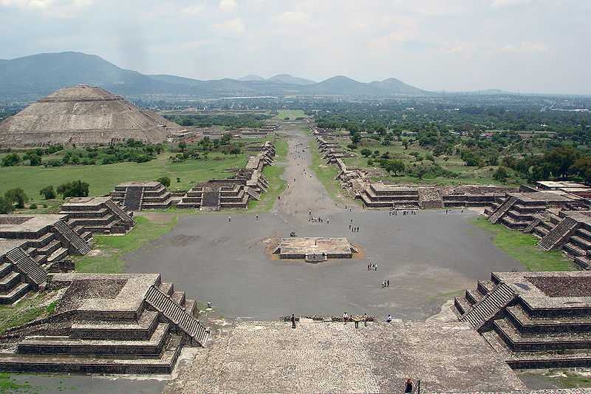
Teotihuacan
Believed to be the Axis Mundi for the Aztec tradition.
A place where all the gods gathered and created the world.

Slide 8
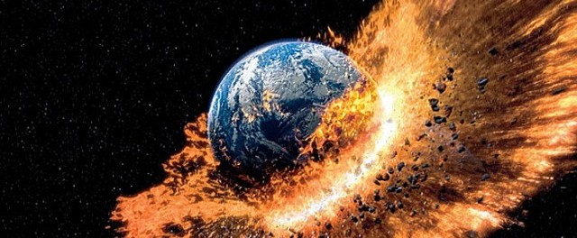
Aztec Beliefs
Aztec belief is influenced by their pessimistic view of the future.
Believing that the worst will happen

Slide 9
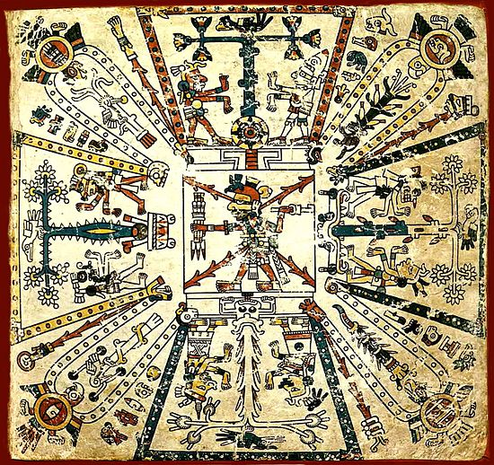
Aztec Cosmology
Age of the 5th Sun
Each Sun had a specific location.
Ours is in the East

Slide 10
Age of the 5th Sun
They believed that the first four suns have already been destroyed.
They believed that our Sun is the last of its kind and its destruction will lead to the end of existence.

Slide 11
Rituals
Idea started because of belief in main sun god Huitzilopochtli
They believed that the sun god fought the moon and star gods every night to bring life to the earth so mankind could live
Aztec people worshiped the sun god and felt obligated to repay him for fighting their battle by nourishing him

Slide 12
How can we save our World?
Aztecs believe that the Human condition is connected to the divine.
It is believed that we are a kind of Axis Mundi.
There are two locations in our body that has divine energy.
Head
Heart
These divine energies are said to nourish the sun.

Slide 13
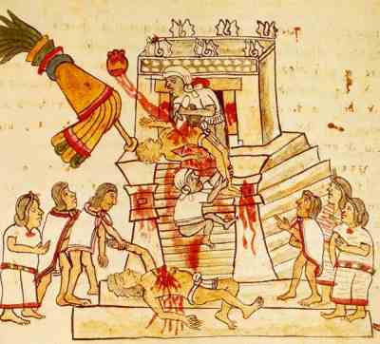
Human Sacrifice
The sacrifice was meant to walk up the temple steps where the priests were ready to make the Sacrifice.
Head to the Sun
Heart to the Sky

Slide 14
Aztec Civilization Flourished
Empire grew through conquest.
Culture grew too.
Art
Literature
Nahuatl- Language of the Aztecs that was expressive and worked well with Poetry and Stories.

Slide 15
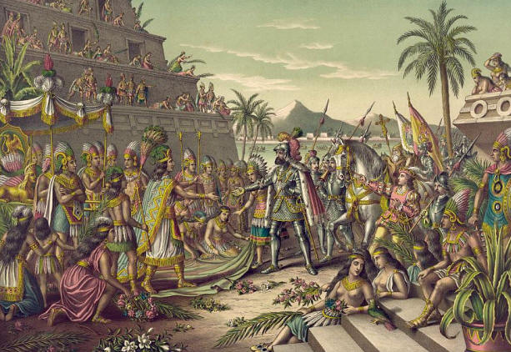
The end of an empire
It was believed that Tepeltzen Quetzalcoatl was coming around 1519.
Hernan Cortez and his Men came 1521
Moctezuma II believed Cortez, who was wearing a feather, was Tepeltzen returned.

