Slide 1
New Semester! New Challenges!
Future
Family
Friends

Slide 2
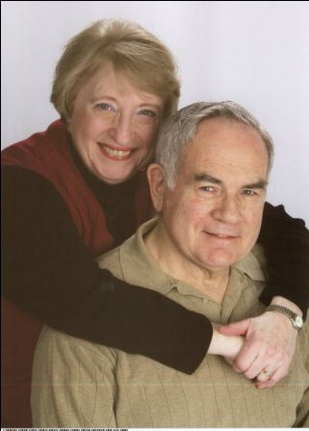
Christian Lifestyles
2nd Semester 2011

Slide 3
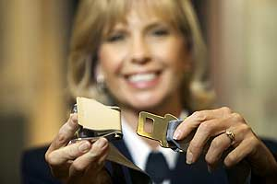
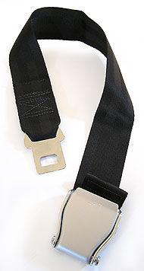
We will talk about the obvious!
Just because you think it’s obvious it does not mean it’s not important!!!

Slide 4
Our lives are full of transitions.
For most of you…
For Some…

Slide 5
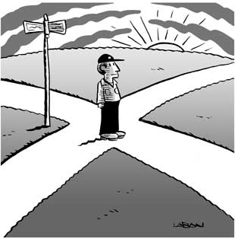
Transitions are filled with both danger and opportunity!
The question is, how are you going to face it?

Slide 6
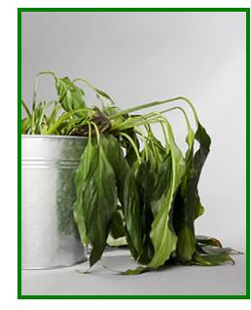
OR

Slide 7
A Call to be “Fully Alive”
Just like the plant we have the opportunity to grow and be fully alive
But we are different from the plant
We have a conscious part in making our growth happen

Slide 8
Finish the following statements at least 3 times:
Regarding your past:
If only…. I would have…
Regarding your future:
I can’t wait until…
because…

Slide 9
Our consciousness gives us the gift of “The Present Moment!”
“Your life is the sum of your present moments, so if you’re missing lots of them, you may actually miss much of your life.”
Dr. Jon Kabat-Zinn
We tend to look at our past and our future:
If only…
I can’t wait until…

Slide 10
What is Christian Lifestyles?
For Christian’s, Jesus is the model of living fully.
He calls all of us to fulfill our complete potential
Not just how we think we should be
How we are supposed to be!!!

Slide 11
The lives of Seniors are filled with a lot of problems that you all have to face.
Write your responses to this question
What concerns, problems, or worries are on your mind? List at least 10 without repeating the same idea.
Group your problems in the following categories:
Family
Social life
School
Career
Personality
Choose 5 concerns that are the most important to you at this time numbering them from 1-5
At the bottom of your paper, explain why your number 1 problem is the most important to you?

