Slide 1
Christian Lifestyles
Learning to live fully

Slide 2
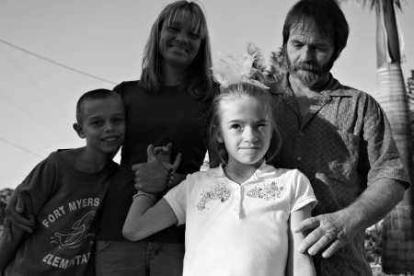
Dani. Age 7

Slide 3
Living Fully
We can be alive and not do anything meaningful with our lives.
What significant thing have you done these last 4 years of High School?
Being fully alive does not mean having fun, having a lot of friends, being popular.
Being fully alive means that your life has meaning.

Slide 4
Identity
In order to be fully alive, we must gain a sense of who we really are.
We can’t know who we are completely because we should be changing every day.
We need to be able to:
Name
Claim
Honor
Who we truly are.

Slide 5
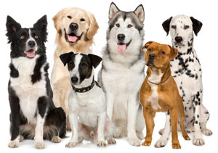
Awareness of the “Unique You”
We have the ability to be aware of who we are as an individual
Dogs only think about
Eating
Sleeping
And waiting for someone to play with them

Slide 6
Complete each statement as fully as you can:
When I join a new group, I feel…
When people first meet me, they…
When people stay quiet, I feel…
I feel most annoyed when…
In a group, I am most comfortable when…
In a group, I am most afraid of…
I feel most alone when…
Those who know me best think I am…
I trust people who…
I am saddest when…
I trust people who…
If I could do it over again, I…
My greatest strength is…

Slide 7
Sense of identity
We have a “Sense of identity”
Personality Traits
Abilities
Strengths
Weaknesses
Interests
Values

Slide 8
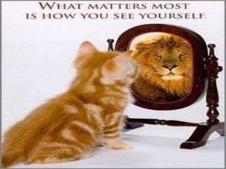
Self-esteem
Built on past experiences
Requires Self-esteem

Slide 9
Knowing Yourself questionnaire.
Knowing yourself involves answering the following questions honestly.
What am I feeling?
What do I want?
What are people telling me?
What are my talents?
What is out of my control?

