Slide 1
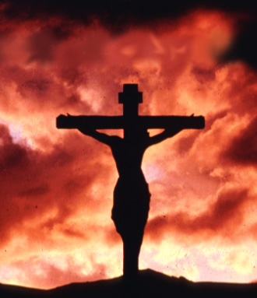
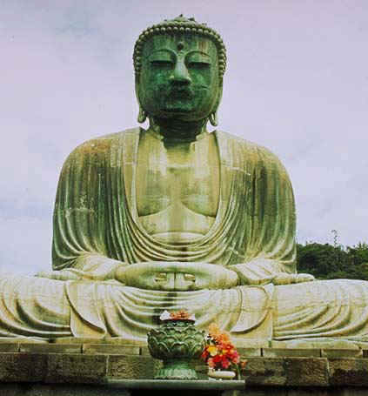
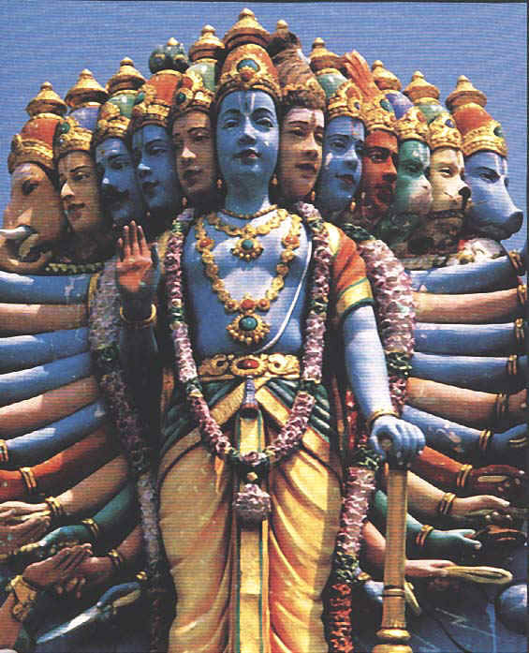
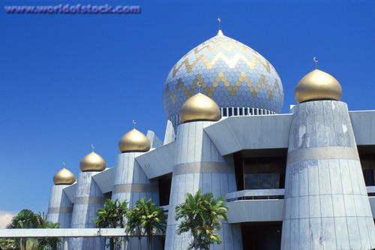
World Religions
A Voyage of discovery

Slide 2
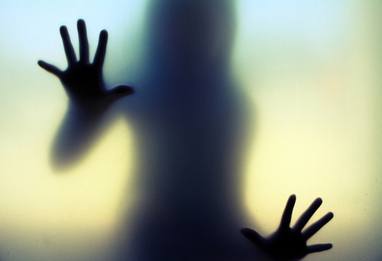
The Nature of Human beings
We are self conscious beings.
We are unique in that we have the capacity to question the source and the meaning of our existence.
We question what is outside our physical beings..
This makes us not only physical, but spiritual beings too.

Slide 3
The Nature of Religion
Religion comes from our unique ability.
Unlike any other animals we are able to question our existence.
Where did we come from?
Where are we going?
Why are we here?
What is the nature of this world?
No matter what religion, faith, or culture we belong to, all human beings at one point or another (even if you didn’t know it) have asked:
“What is the nature of the supreme or ultimate reality?”

Slide 4
Religion answers the Human condition.
What is our essential nature?
Are we just physical bodies that are able to think or are we spiritual beings with some sort of soul?
Are we inherently good or bad? Or maybe we are somewhere in between?
Why do we suffer?
IF we are inherently good, why do we suffer? Did we do something wrong?
IF we are inherently bad, then maybe we deserve what is happening to us.

Slide 5
Religion comes from this mystery.
It is impossible for human beings to answer all these questions.
Religion offers us a way to find some truths that we might not be able to get otherwise.

Slide 6
Class work
What would you consider your Religion to be. If you don’t have a name for it give me a brief description.
Based on your Religion, answer the following questions.
Where did we come from?
Why are we here?
Are we just physical bodies that are able to think or are we spiritual beings with some sort of soul?
Are we inherently good or are we inherently bad? Why do we suffer?

