Slide 1
Chapter 1: Continued

Slide 2
The prayer of St. Francis
Lord, make me an instrument of your peace, Where there is hatred, let me sow love; where there is injury, pardon; where there is doubt, faith; where there is despair, hope; where there is darkness, light; where there is sadness, joy;
.

Slide 3
O Divine Master, grant that I may not so much seek to be consoled as to console; to be understood as to understand; to be loved as to love.
For it is in giving that we receive; it is in pardoning that we are pardoned; and it is in dying that we are born to eternal life

Slide 4
Purpose of Religion cont’d…
As a person, it is only natural for us to seek out our Human Condition.
Who, what, where, when, why, and how are we?
Religion allows us to answer these questions.
What are other things that religion can teach us?
Spiritual Perfection
Transcendence
Ultimate Reality

Slide 5
What is Spiritual Perfection?
Religions teach us how to achieve Spiritual perfection or Maturity
When can we achieve Spiritual Perfection?
In this life or the afterlife?

Slide 6
How do we transcend the Human Condition?
Religions teaches us transcendence.
How we can surpass the physical limitations of the human body.
Religion teaches us about Salvation
Escaping the physical world to a spiritual world.

Slide 7
What is ultimate reality?
Theistic Religions: Religions who believe in a God.
These religions believe that Ultimate reality is God. God is the source of all creation.
Non-theistic Religions: Religions who do not believe in a God.
There could be another source.

Slide 8
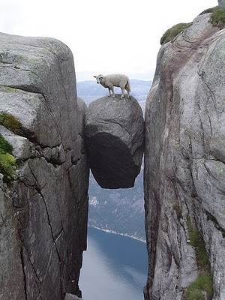
Explain what these images are referring to.
2.
1.
3.

Slide 9
7 Dimensions of Religion
Experiential
Mythic
Doctrinal
Ethical
Ritual
Social
Material

Slide 10
Experiential
Religions begin with Religious experience
An experience of God or some other that we cannot explain.
Some experiences begin religions
Some are just day to day experiences that we have

Slide 11
Mythic
Religions have a Mythic quality to it.
Mythic: traditional stories that are told over the centuries.
It tells the people the fundamental truths about the religion.

Slide 12
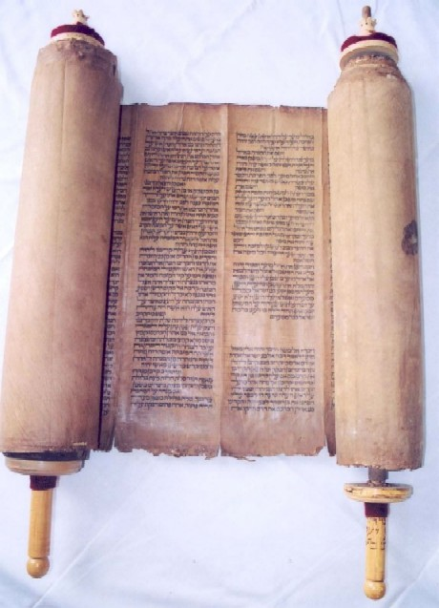
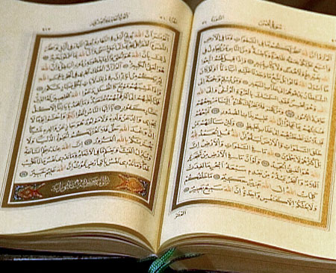
Doctrinal
Religions have Doctrine.
Recorded laws, rules, advice, or thoughts, that help people understand the religion.

Slide 13
Ethical
Religion devotes its time to ethics.
Teaches its people the expectations of the Religion.
What is good and what is bad.
What are possible consequences.

Slide 14
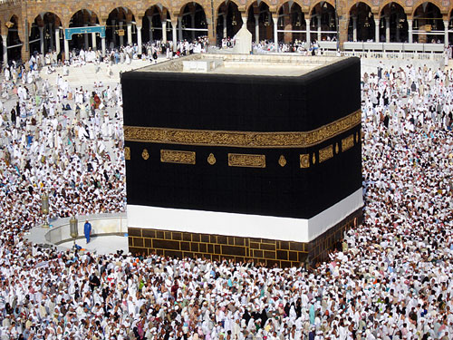
Ritual
Religion has formal practices of Worship.
They reenact myth, sacred stories in order to express their beliefs.

Slide 15
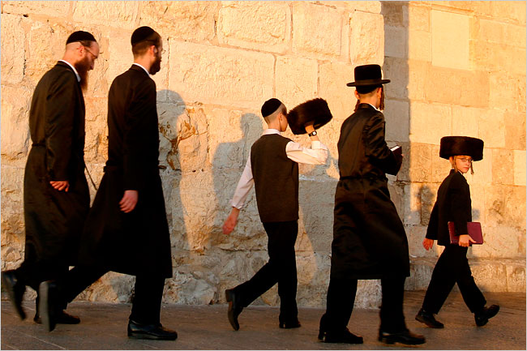
Social
Religions involve Community
The experiences of the group help make everyone's experience better

Slide 16
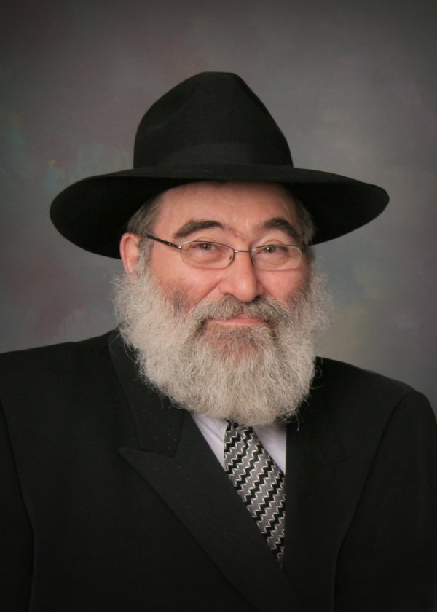
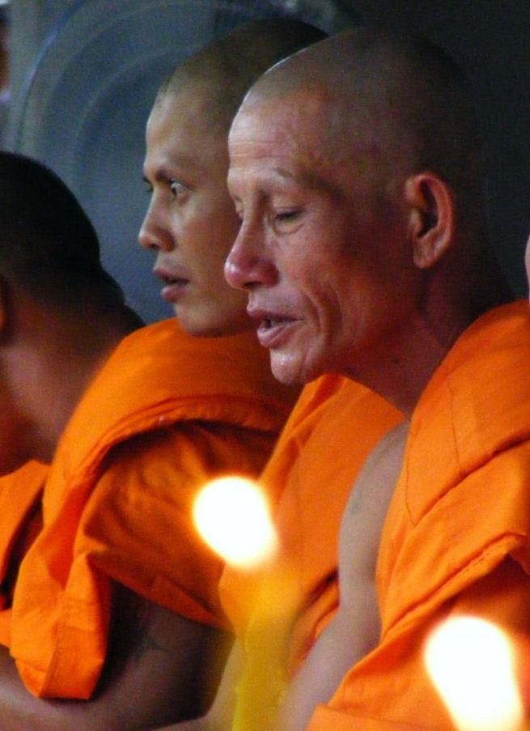
Social continued…
Part of the Social aspect of Religion is Hierarchy of Leadership.

Slide 17
Material
Religions have material objects that symbolizes a religion.

Slide 18
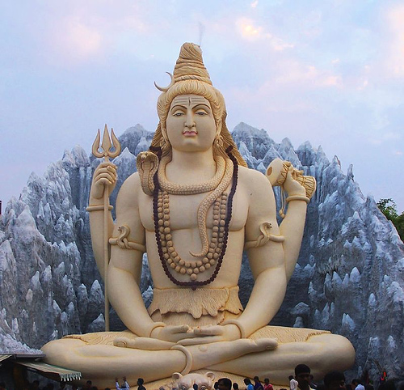
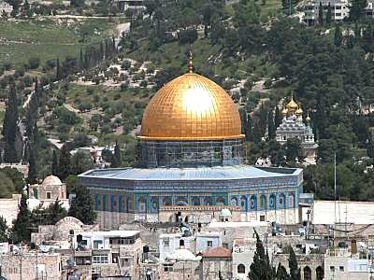
Material continued…

Slide 19
Material continued…

