Slide 1
Chapter 2: Growth for Life

Slide 2
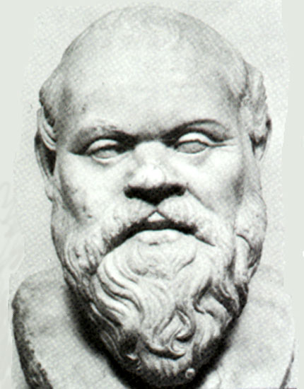
Socrates
“The unexamined life is not worth living.”
Socrates
Socrates challenged his followers to find meaning in their lives.

Slide 3
Christian lifestyles twist on Socrates
“The unlived life is not worth examining.”
What does it mean to truly live life?
Constantly growing
Not content on being stuck in a rut
Seek out new experiences
Looking to challenge themselves
Learn

Slide 4
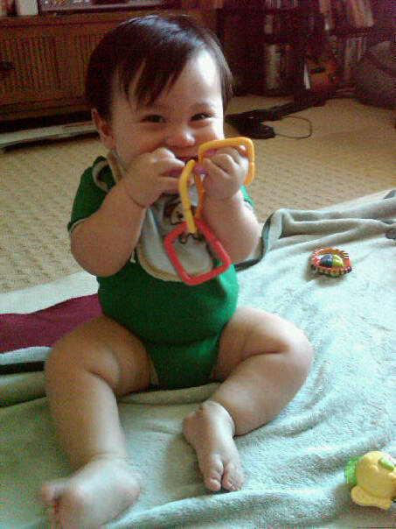
My Godson Noah

Slide 5
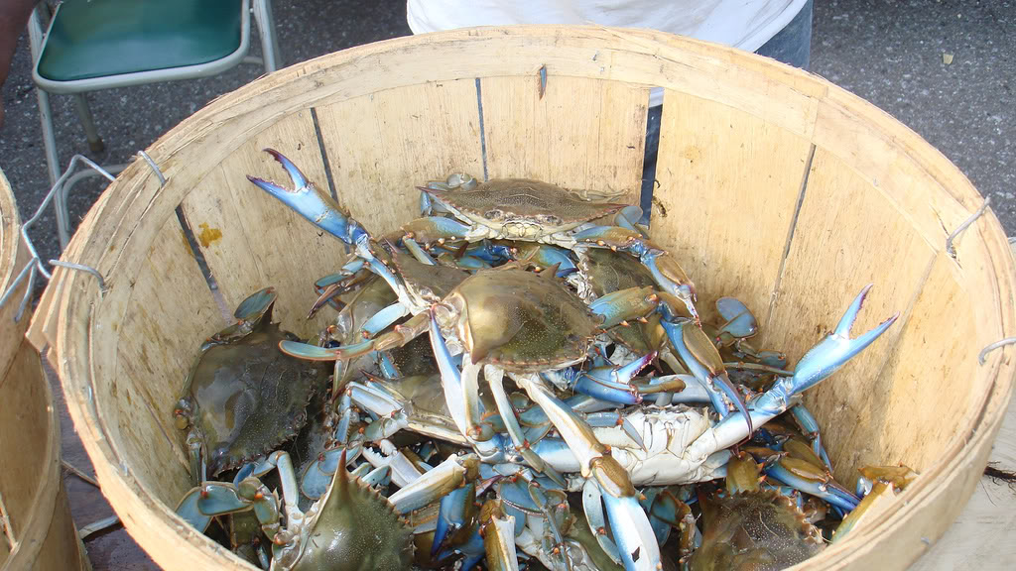
Crab mentality

Slide 6
Watch out!!!

Slide 7
All of us start like Noah
We all started loving to learn
We accept language
They want to learn the why and how of everything
They soak up everything that life has to offer

Slide 9
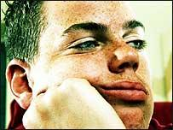
At a certain point:
We become self-conscious
We become scared
We become unsure about ourselves
We lose our spontaneity

Slide 10
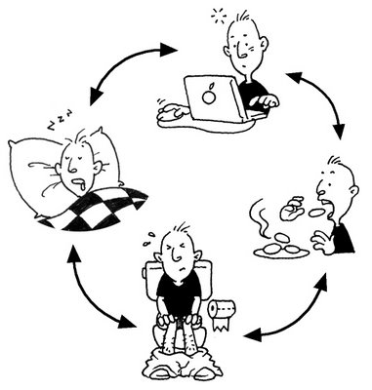
We find a routine in our lives.

Slide 11
We can’t let routine get in the way of our lives!!!!

Slide 12
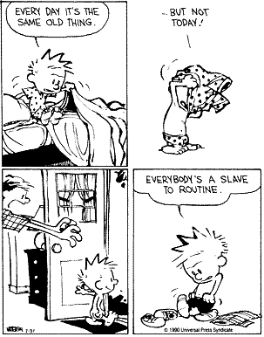
It’s not that easy!!!

Slide 13
What should we do?
Recognize that we have potential.
There is someone we are supposed to be
There is something that we are supposed to do
Find people who can help you find your potential
Group Games Rule:
“Don’t pick your friends!!!!”

Slide 14
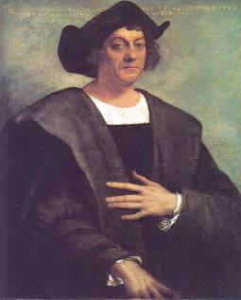
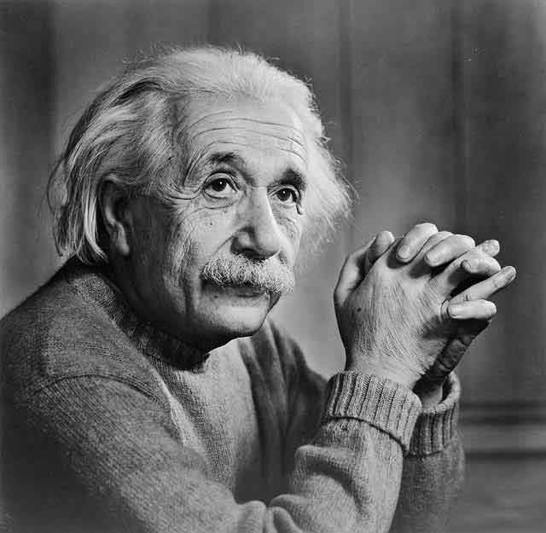
Famous people that were made fun of!!!
Christopher Columbus
Albert Einstein

