Slide 1
Growth through Creativity

Slide 2
"It will be as when a man who was going on a journey called in his servants and entrusted his possessions to them.
To one he gave five talents; to another, two; to a third, one--to each according to his ability. Then he went away. Immediately the one who received five talents went and traded with them, and made another five.

Slide 3
Likewise, the one who received two made another two.
But the man who received one went off and dug a hole in the ground and buried his master's money.

Slide 4
After a long time the master of those servants came back and settled accounts with them.
The one who had received five talents came forward bringing the additional five. He said, 'Master, you gave me five talents. See, I have made five more.'
His master said to him, 'Well done, my good and faithful servant. Since you were faithful in small matters, I will give you great responsibilities. Come, share your master's joy.'

Slide 5
(Then) the one who had received two talents also came forward and said, 'Master, you gave me two talents. See, I have made two more.'
His master said to him, 'Well done, my good and faithful servant. Since you were faithful in small matters, I will give you great responsibilities. Come, share your master's joy.'

Slide 6
Then the one who had received the one talent came forward and said, 'Master, I knew you were a demanding person, harvesting where you did not plant and gathering where you did not scatter; so out of fear I went off and buried your talent in the ground. Here it is back.'
His master said to him in reply, 'You wicked, lazy servant! So you knew that I harvest where I did not plant and gather where I did not scatter?

Slide 7
Should you not then have put my money in the bank so that I could have got it back with interest on my return?
Now then! Take the talent from him and give it to the one with ten.
For to everyone who has, more will be given and he will grow rich; but from the one who has not, even what he has will be taken away.

Slide 8
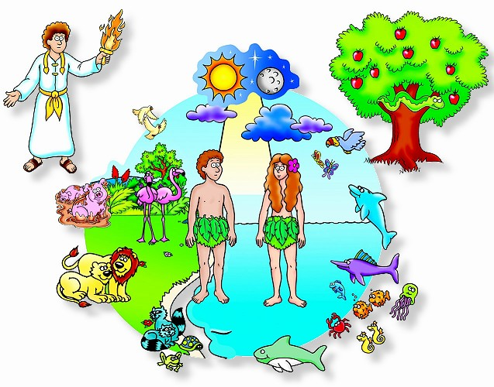
The Creation Story

Slide 9
We were created in the image of God!
God created the universe
If we are created in the image of God then we must be “God-like”
We are born with the inherent gift of creativity

Slide 10
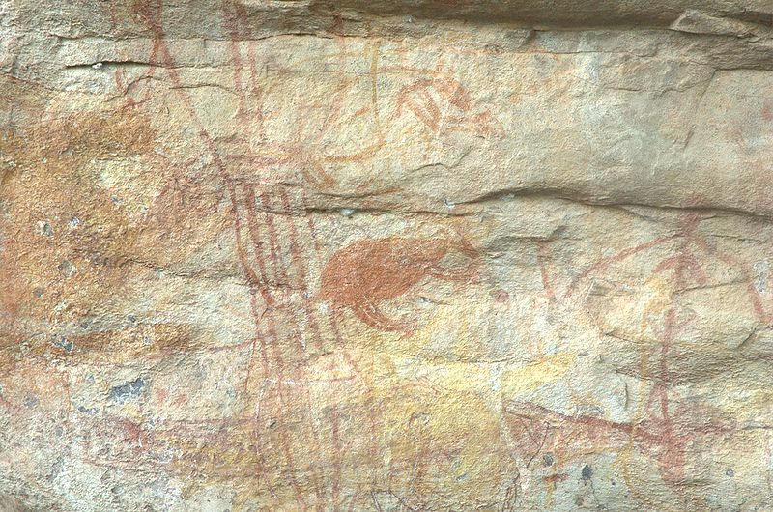
Auroch painting in Australia

Slide 11
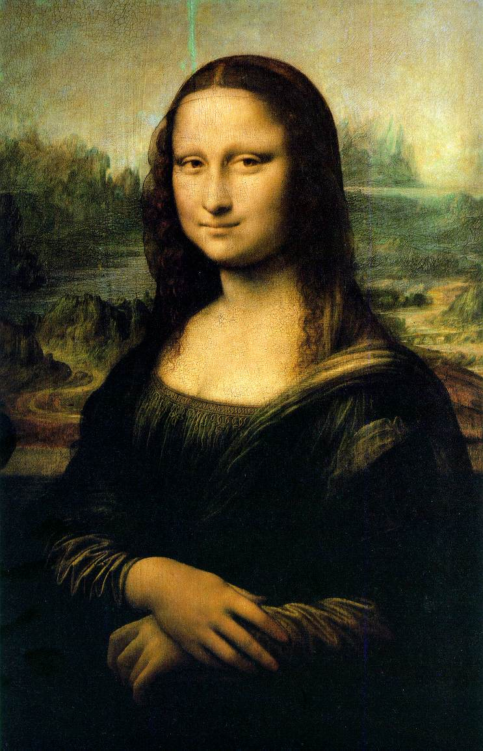
Mona Lisa

Slide 12
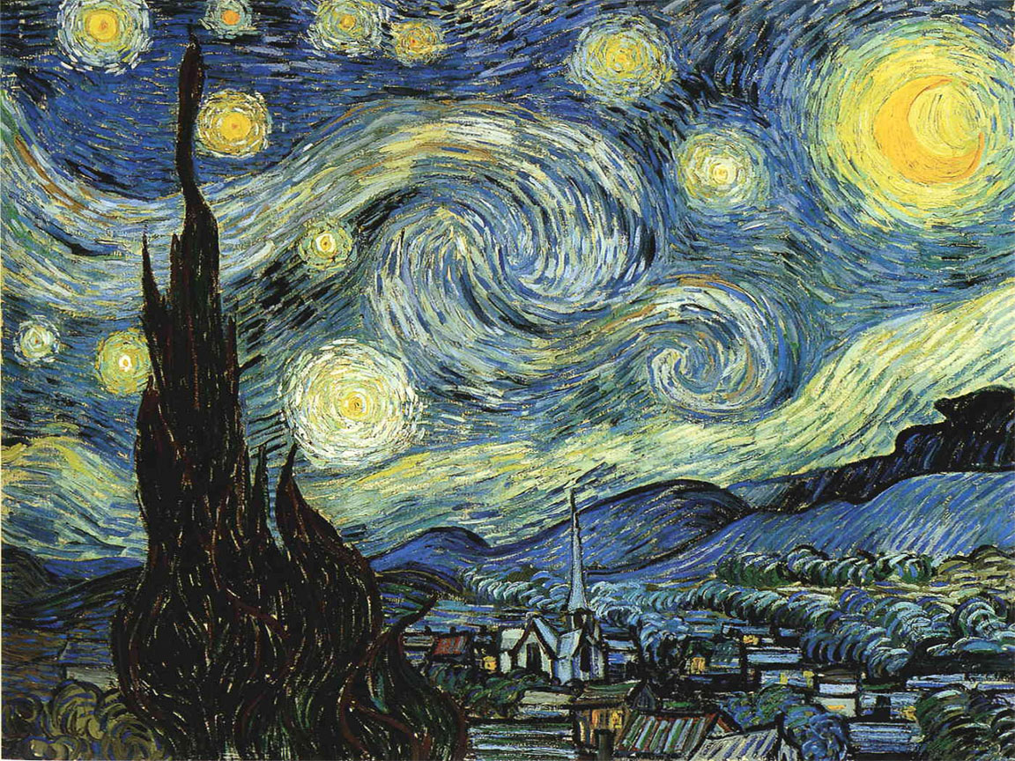
Starry Starry Night

Slide 13
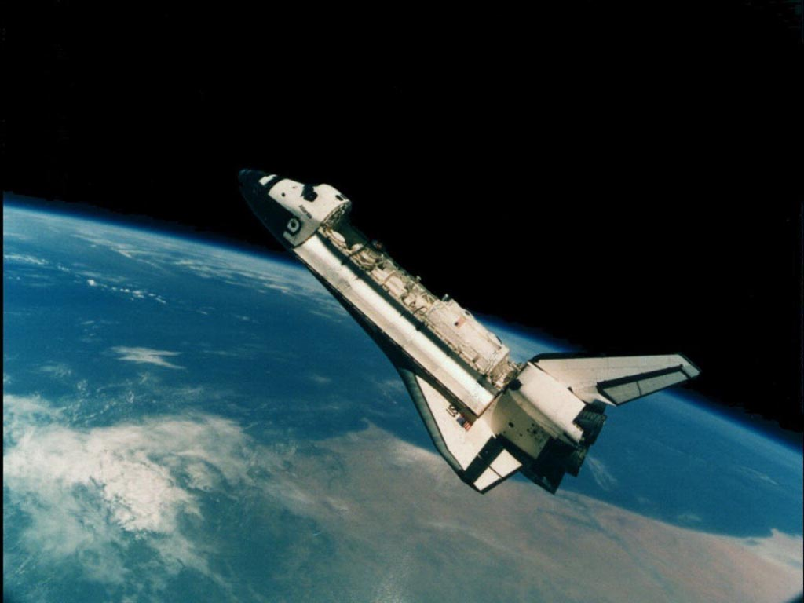
Creativity in life.

Slide 14
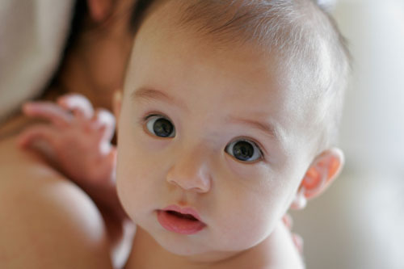
Inherent need to create!!!

Slide 15
Creativity
The Human drive to make something out of nothing
Since the early times of human history our ancestors have had the need to express themselves creatively.
We can find a link between creativity and successful people

Slide 16
Anyone can be creative
Not everyone who is painter, actor, singer, poet, or writer has to be educated or trained.
Never Finished College
John Steinbeck
William Faulkner
Ernest Hemingway
Emily Dickinson
Not all creative people succeed the first time
Thomas Edison – failed 1000 times to invent the lightbulb

Slide 17
What do we need?
Opening our hearts and minds to the possibility
Trying out new things
Surrounding ourselves with the right people
Looking to develop appropriate skills
If you want to write, practice writing
If you want to sing, practice singing

Slide 18
Steps in Creating
Preparation to create
Concentrated work
Genius is 1 Percent inspiration, 99 percent perspiration. (Thomas Edison)
Rest and retreat
An “aha!!!” moment
Trying out the insight

Slide 19
What else is needed?
Leisure time
“All work and no play makes Jack a dull boy”
Even God rested on the Sabbath.

