Slide 1
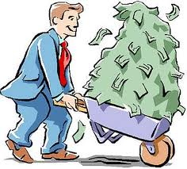
Money and Possessions
Chapter 4

Slide 2
You just won the Lotto!!!
What would you do if you won 5 Million dollars?

Slide 3
Interesting fact of the day…
1 out of 3 lotto winners go bankrupt after only a couple of years.
Overspending
Family and “Friends”
Buying things that they did not need

Slide 4
Enough versus Excess

