Slide 1
Money and Possessions
Part 2

Slide 2
A cry for “Soul Food”
Our Soul needs to be satisfied
If our soul cannot find satisfaction it looks for other things to fill the void
Since material things cannot fill the void this emptiness just grows and grows
Do I equate money or possessions with happiness?
Do I harbor the belief that if I only had a certain amount of money or certain things, I would be happy?
Do I turn to buying things when I feel restless or unsatisfied?

Slide 3
Self image vs. Self-worth
Buying things to make ourselves feel better about our self image.
Have I told myself, even subconsciously, things like, “I’d really be attractive or popular if I had…”
Do I judge other people’s value on what they have or how much they spend?
Do I get a rush when I buy an item that I know will make me the envy of my friends.

Slide 4
False sense of freedom
Compulsive Spending
People who find pleasure in buying things
Do you shop to relieve feelings of disappointment, boredom, loneliness, sadness, and low self-esteem?
Does your buying need cause problems with your family?

Slide 5
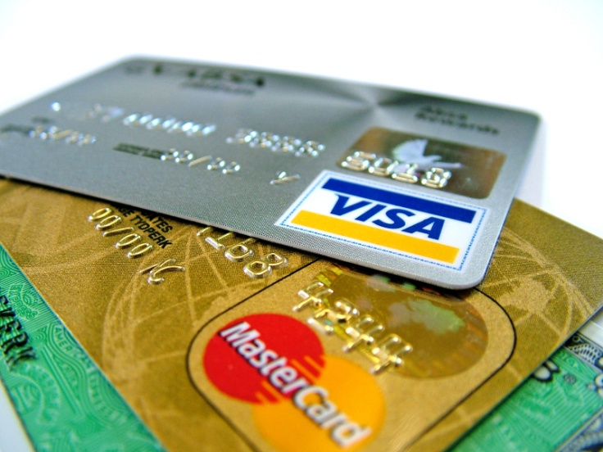
The Credit Card trap
Average APR 14.74%
$1000 + $147.40 = $1,147.40
If you pay the minimum of $50.00
$1,097.40 + $161.76 = $1,259.16

