Slide 1
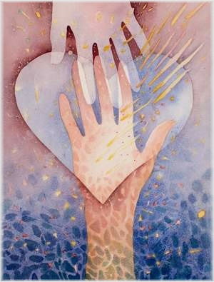
Sexuality
Energy for relating with others

Slide 2
Sexuality: Christian Perspective
Often times when Religion classes talk about Sexuality we ask the question:
Should we have sex?
Yes or no?
Sex is only a part of human sexuality!!!

Slide 3
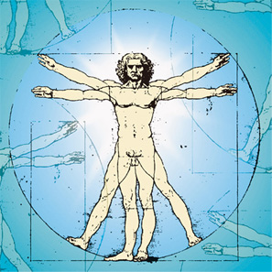
Humans created in God’s image
“So God created humankind in his image, in the image of God he created them; male and female he created them.” (Gen 1:27)
We were created as “Sexual creatures”
It is at the center of who we are
We were created to:
Love
Be loved
We were made for relationships
We long for relationships
Just like God longs for a relationship

Slide 4
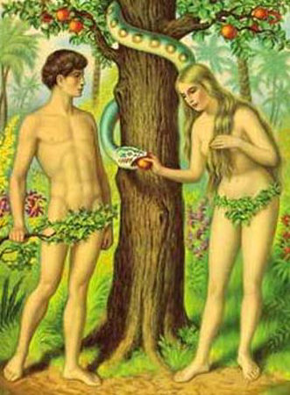
Sexuality according to the Bible.
“The LORD God said: "It is not good for the man to be alone. I will make a suitable partner for him." (Genesis 2:18)
“That is why a man leaves his father and mother and clings to his wife, and the two of them become one body. The man and his wife were both naked, yet they felt no shame.” (Genesis 2: 24-25)

Slide 5
Not Shame, but joy
God intended sexuality to be holy.
Human beings have overshadowed and distorted sexuality with sin, shame, etc…
We are called to that original state of healthy, happy sexuality.

Slide 6
So… what is sexuality?
Sexuality does not necessarily mean “sex”. It is only part of it.
Sexuality is an energy that drives us to form relationships with others; men or women.
Relationships of all kinds.
Emotional
Physical
Spiritual
Intellectual

Slide 7
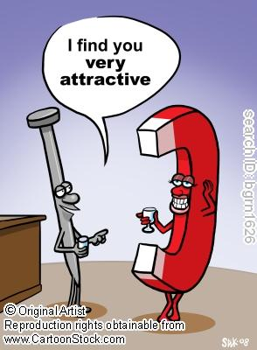
An energy? WTH?
A force the energizes us to find fulfillment in relating to other people.

Slide 8
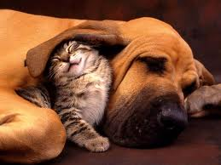
Friends
No matter who they are or what they are.
“Life without friendship is like the sky without the sun”

Slide 9
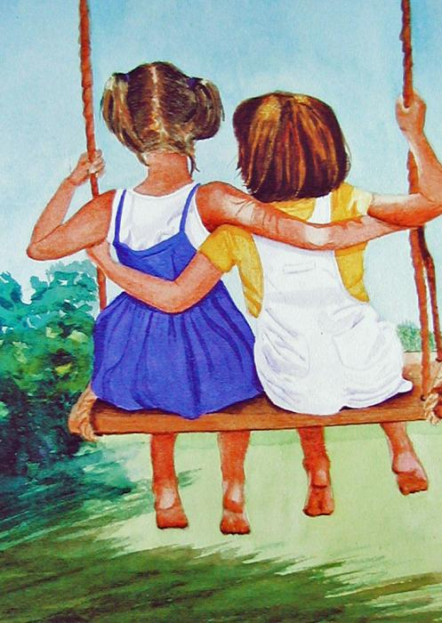
Best Friends
“A friend is someone who lets you have total freedom to be yourself.”
(Jim Morrison)

Slide 10
Boyfriend or Girlfriend
“Love is friendship set on fire.”

Slide 11
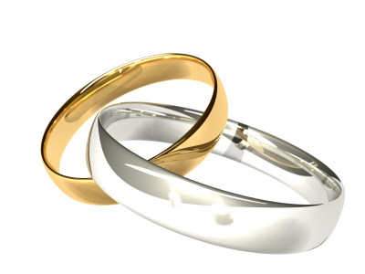
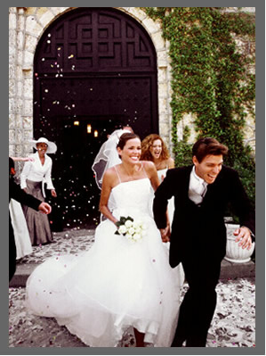
Husband and wife
“Two souls with but a single thought, two hearts that beat as one.”

Slide 12
Strong energy that can overpower us
Sometimes these urges to form relationships make us do stupid things
Because of our urges we tend to distort it beyond what it was originally meant to be.

Slide 13
Healthy ways of expressing our sexuality
Let your fountain be blessed, and rejoice in the wife of your youth, a lovely deer, a graceful doe. May her breasts satisfy you at all times; may you be intoxicated always by her love.
In the Hebrew scriptures, sexual attraction of lovers is described in very moving and passionate terms.
Saint Paul recognized that the body is a temple. That it is special.

Slide 14
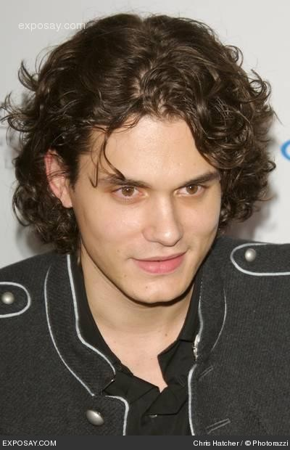
John Mayer vs. Saint Paul
You want love? We'll make it. Swim in a deep sea Of blankets. Take all your big plans. And break 'em This is bound to be awhile.
You’re body is a wonderland!

Slide 15
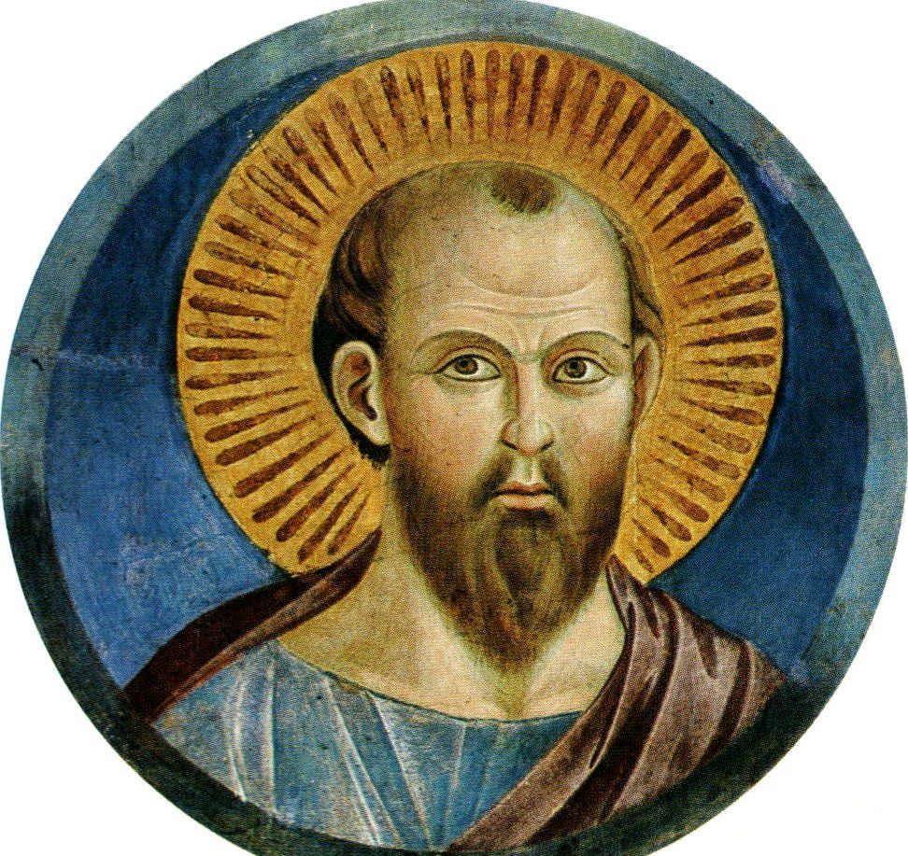
John Mayer vs. Saint Paul
Your body is wonderland!!!
But your Body is to be used for love, not for selfish enjoyment that implies no commitment to the other person.

