Slide 1
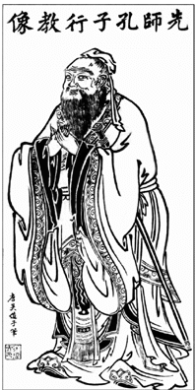
Confucianism

Slide 2
Confucian Tradition
Book of Mencius
Human Beings are Naturally Good. But they coomit evil acts that violate their true nature.
Official Education
Anyone who wanted to be educated, or become a Government official needed to learn the Confucian texts

Slide 3
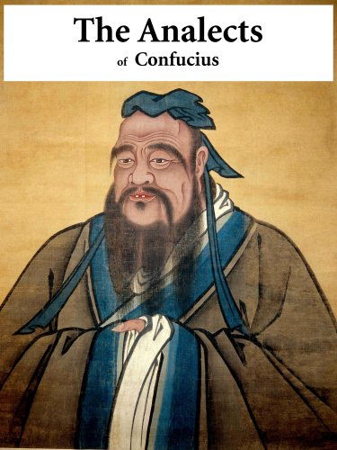
Confucian Tradition
Neo-Confucianism
A response to the rise of other religions
Chu Hsi
One of the greatest Confucian Philiosophers
Translated Confucian teachings that is still studied today.
Analects
Book of Mencius
Great Learning
Doctrine of mean

Slide 4
Confucianism’s Central Goal
Learning to be Human
Tao
Chun Tzu
Jen
Li
Wen
Te

Slide 5
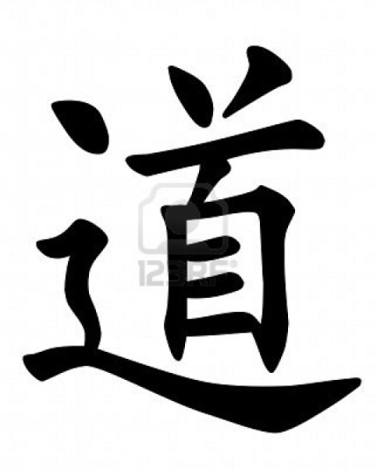
Learning to be Human
Tao: “The Way”
Moral law of the Universe
If we can get to know the Tao then we can live in Harmony with it.

Slide 6
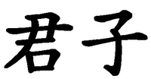
Learning to be Human
Chun Tzu: The ideal Human Being
A Person with perfect Morals
Someone with so much virtue that he can change the world
A mature person, a Gentleman.
One must start with learning, to achieve become Chun Tzu

Slide 7
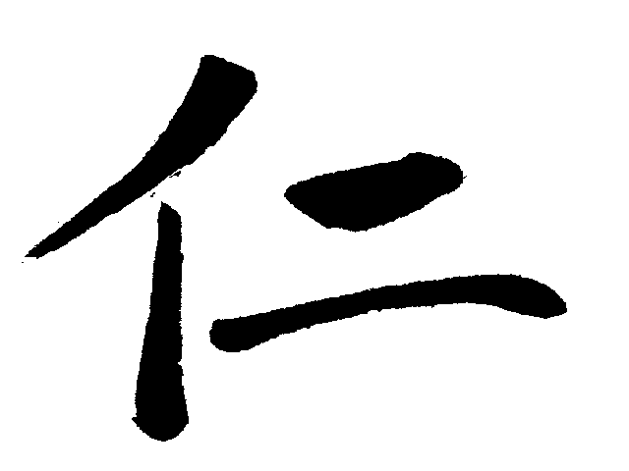
Learning to be Human
Jen: Goodness, love, benevolence
Two Characteristics of jen
Doing one’s best
Shu- Reciprocity – “Do Unto Others”
Confucianism does not believe in “Love your enemies.

Slide 8
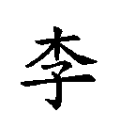
Learning to be Human
Li: Proper behavior in every situation
Depending on where you are, what you are doing, and who you are with; you have proper ways of acting.

Slide 9
Learning to be Human
Wen: Cultural Arts
A person who studies and appreciates Cultural arts is said to be learning moral virtues
Confucius believed that you become a better person when exposed to Cultural Arts.
Music
Literature
Art
Dance
文

Slide 10
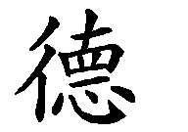
Learning to be Human
Te: Virtue as shown through example
Instead of telling a person how one must act, a Chun Tzu will educate society through his actions.

Slide 11
文
TAO
CHUN TZU
WEN
TE
JEN
Li

