Slide 1
3 Major types of Religion
•Abrahamic religions—draw origin back to Abraham—Judaism, Christianity, Islam,
•Dharmic religions--family of religions that originated from the Indian subcontinent—Hinduism, Buddhism, Jainism, and Sikhism.
•Taoic religions--religion, or religious philosophy, that focuses on the East Asian concept of Tao, or The Way—Taoism, Confucianism, Shintoism

Slide 2
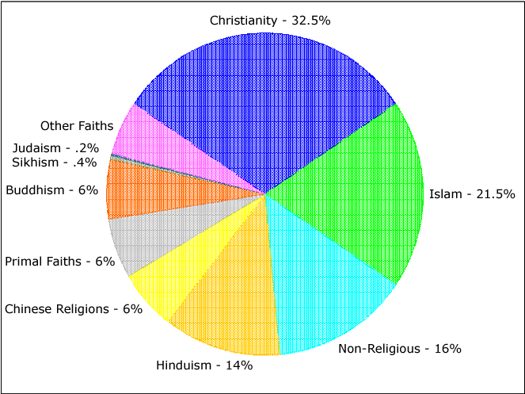
Major Religions of the World

Slide 3
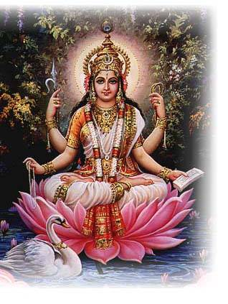
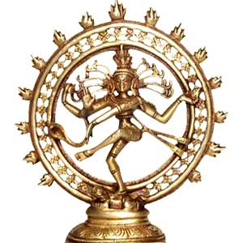
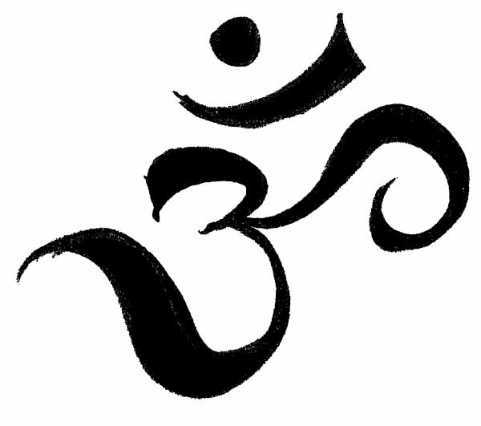
Hinduism
Chapter 3

Slide 4
‘There is only one God, but endless are his aspects and endless are his names. Call him by any name and worship him in any aspect that pleases you, you are sure to see him’

Slide 5
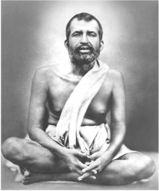
Shri Ramakrishna (1836 – 1886)
Emphasized the harmony and tolerance found in his religion.
A harmony of many beliefs and practices, all aiming for the common goal of salvation
During his youth he became a:
Christian
Muslim

Slide 6
Many rivers all go to one ocean.

Slide 7
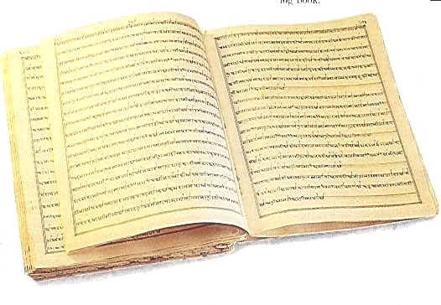
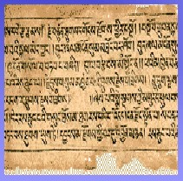
Tolerance of other faiths
Rig Veda: The nearly 4000 year old Rig Veda, Hinduism’s oldest sacred text, declares:
“God is one but men call him by many names”

Slide 8
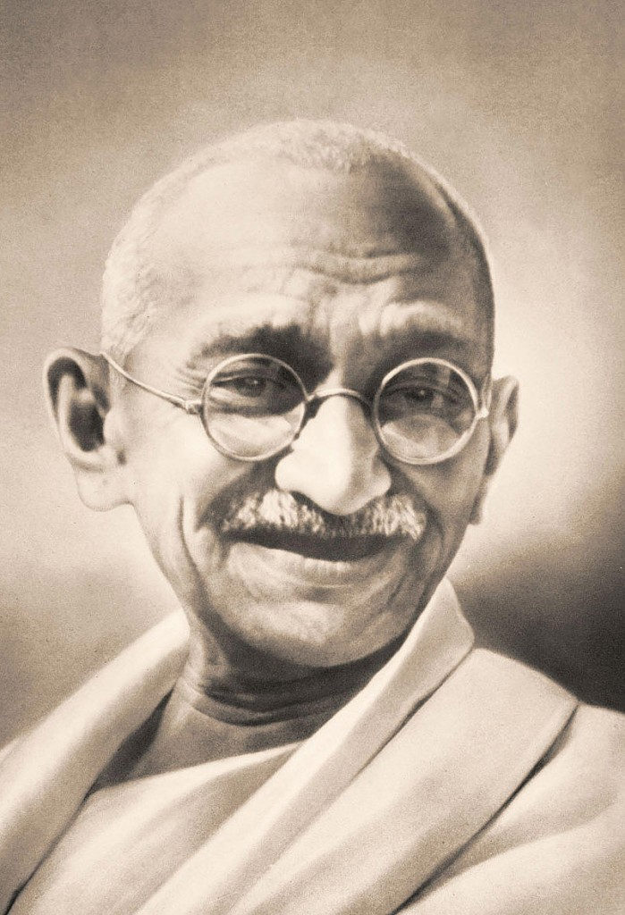
Tolerance of other faiths (cont…)
Mahatma Ghandi
Echoes the ancient wisdom of Rig Veda: ‘Even as a tree has a single trunk, but many branches and leaves, so is there one true and perfect Religion, but it becomes many as it passes through the human medium.

Slide 9
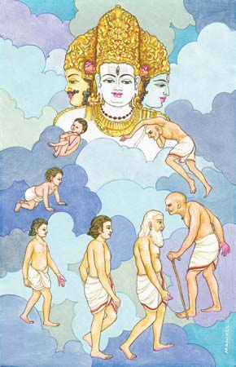
Human Destiny: The end is the beginning
The ultimate goal of Hindus is Salvation. Our liberation from the Human condition
It is something that most people cannot achieve in this lifetime.
Hindus believe in the concept of “Reincarnation”

Slide 10
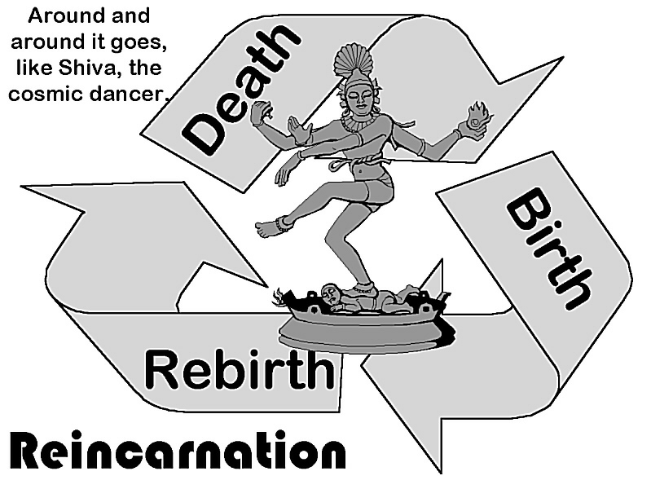
Reincarnation
Rebirth in a new life
Most people expect a series of lifetimes
This allows them to be patient regarding liberation
Hinduism is not in a hurry

Slide 11
Moksha: “release”
The ultimate goal is “Moksha”
Being liberated from the limitations of your body and your souls set free
Never being reincarnated ever again
What is beyond Moksha is indescribable to human words or imagination.
Infinite wisdom
Infinite awareness
Infinite bliss
We are re-united with the divine, returning to the sacred source

Slide 12
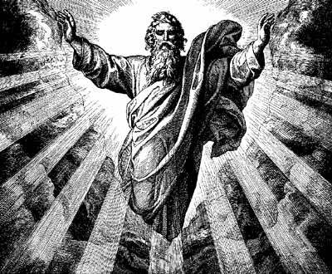
The Divine
Divine in Hinduism is different then Western Religions
Western Religion
Divine = God
Created
All of creation
Hindusim
All of reality, creation, Humanity, even God is essentially one thing

Slide 13
Monism: All is Brahman
Most (Not all) Hindus believe in Monism
Monism versus Monotheism
“Only-one-ism” versus “Only-one-God-ism”
Monism is the belief that all of reality is one.
It is believed that all of creation, plants, animals. Gods, goddesses, everything, share a common essence.

Slide 14
Brahman
Infinite, eternal, unexplainable.
Source of all creation.
It has no characteristics that can be seen, heard, felt, or even thought of
Upanishads: Philosophical text that form most of Hindu doctrine
Neti Neti: “Not this, not that”
Brahman is beyond human understanding or even imagination

Slide 15
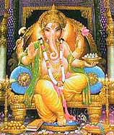
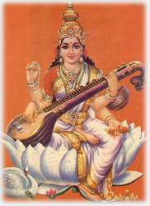
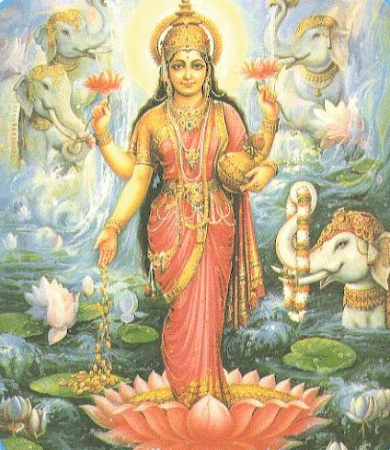
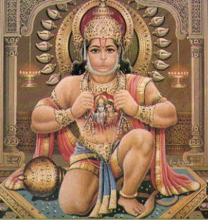
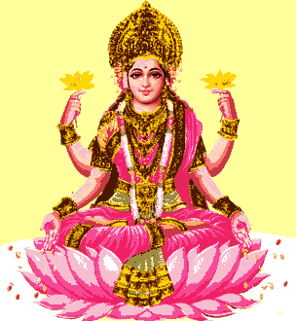
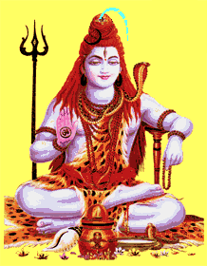
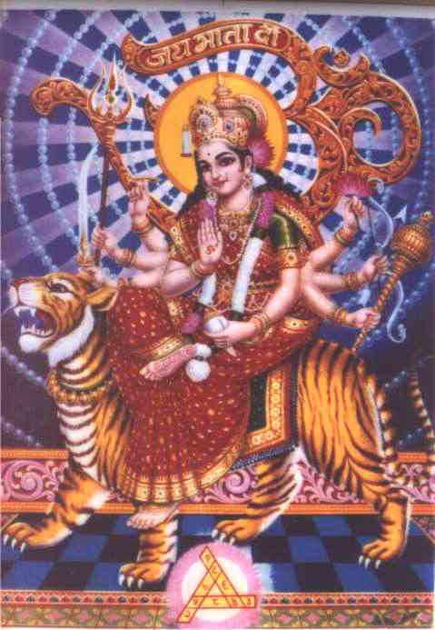
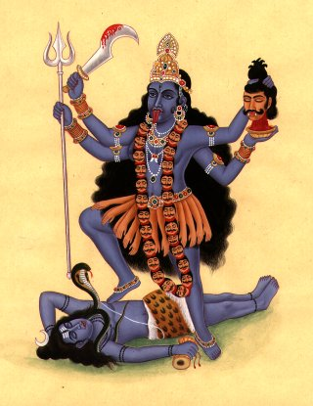
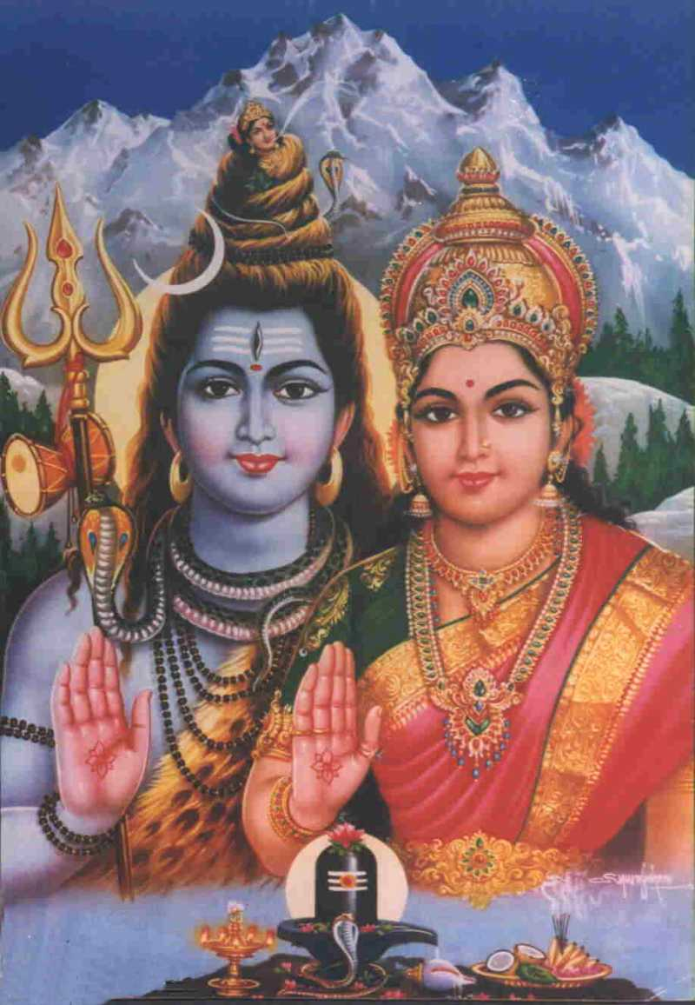
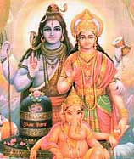
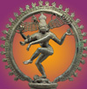
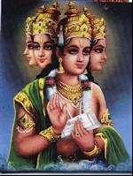
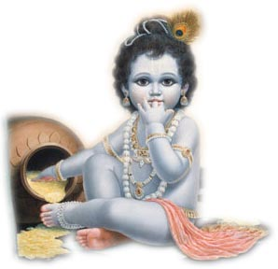
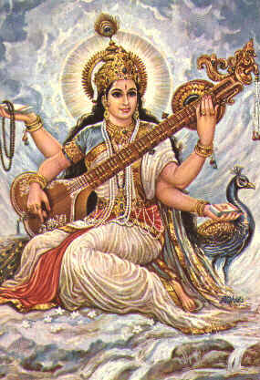
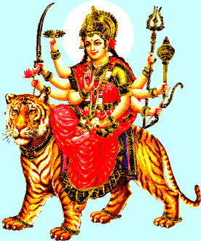
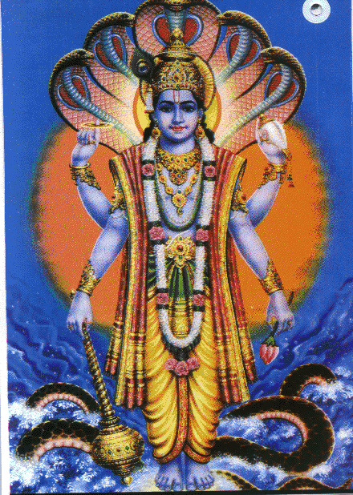
Is Hinduism Monistic?
Hinduism is Polytheistic
Belief that there are more than one god.

Slide 16
Who do Hindus worship? – the major gods of the Hindu Pantheon
Shiva, god of constructive destruction (the transformer)
Appears as Shiva Nataraj, lord of the dance of creation…
and with his wife, Parvati, and son Ganesha (the elephant headed remover of obstacles)

Slide 17
What about the goddesses? Devi – the feminine divine
Saraswati, goddess of wisdom, consort of Brahma

Slide 18
What about the goddesses? Devi – the feminine divine
Lakshmi, goddess of good fortune, consort of Vishnu

Slide 19
What about the goddesses? Devi – the feminine divine
Parvati, divine mother, wife of Shiva

Slide 20
What about the goddesses? Devi – the feminine divine
Durga, protectress
Kali, destroyer of demons
Plus about 330 million other deities

Slide 21
All these deities are
Manifest forms (an extension of the original)of the impersonal Brahman

Slide 22
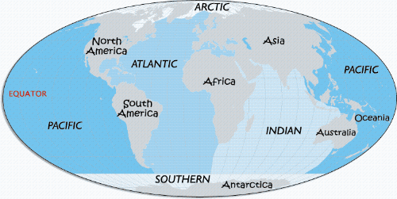
Multiple oceans of the world
BRAHMAN

Slide 23
Hindu Cosmology
The universe has cyclical nature
Life and death has a circular pattern that repeats itself
The universe goes through long periods of creation and destruction. That repeats itself endlessly.
At the end of each cycle, all the destructive power will destroy the universe. Leaving nothingness.
Eventually the universe will begin again.

Slide 24
Samsara: The wheel of rebirth
Hindus believe in Reincarnation
Each of us will be created and re-created over and over again. Until we attain the release of Moksha

Slide 25
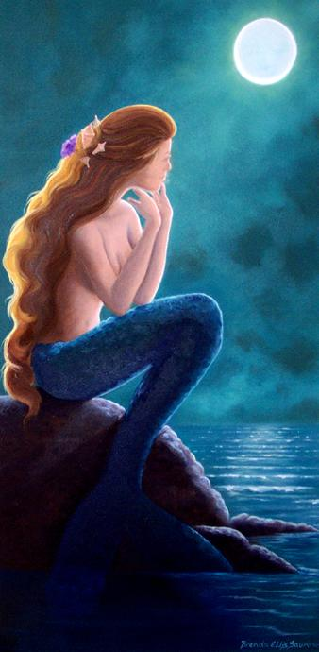
Back to Brahman…
The Upanishads maintain that we can understand ultimate reality through inward contemplation of out inner self.
Atman: our inner self
Understanding the Atman is the same thing as understanding Brahman. They are one and the same.
All is one.

Slide 26
And we too are manifest forms of God!
“We are not human beings having spiritual experiences; We are spiritual beings having a human experience!”
“That art Thou”
Atman = Brahman = Atman

Slide 27
What is reincarnated?
Our Atman, our inner being
Feelings, memories, personality is usually believed NOT to be transferred from one life to another.
Samsara happens in all levels
All things, living, gods & goddesses, demons are subject to Samsara

