Slide 1
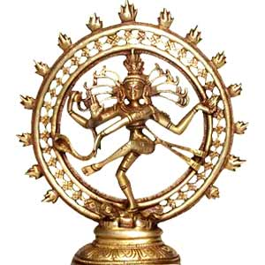
Hinduism

Slide 2
Review
Hinduism is a religion that began in India.
The religion dates back to 1500 B.C., making it the worlds oldest religion.
There are 750 million Hindus in the world today.
Most Hindus still live in India.

Slide 3
Review
Hindus believe in a single Divinity or supreme God that is present in everything called Brahman.
Hindus also believe in other gods who are aspects of that supreme God such as Shiva, Shakti, and Ganesh.

Slide 4
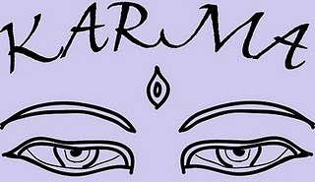
Karma and Reincarnation
Karma- Moral law of Cause and effect
Every action has a reaction
Karma produces an outcome that is determined by the actions’ morality
This outcome determines a persons’ lifestyle and situation.

Slide 5
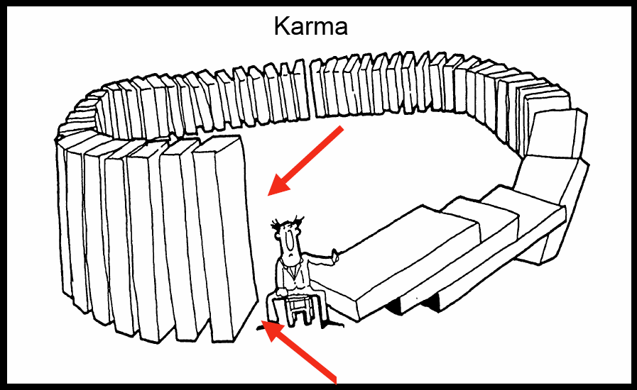
Karma

Slide 6
Karma is independent
There is no God or Goddess that determines whether you did wrong or not. Your actions determine what happens to you.
Your karma stays with you during your reincarnations.
Your karma determines the life form you become when you reincarnate.

Slide 7
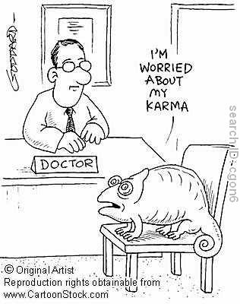
Karma continued…
Will you be a deity or supernatural being? Will you be a human or an animal?
Humans are the only living beings that get to change their karma.

Slide 8
Karma as Justice
Why do bad things happen to good people?
Because they did bad things in their past lives therefore they deserve it.
Criminals will always be punished
Good people will get their reward

Slide 9
Dharma
Dharma-standard of right and wrong
Not just a set of rules; it is how you must live your life.
Dharma is how you must act in every situation.
For every activity there is a proper way to act according to your Dharma.

