Slide 1
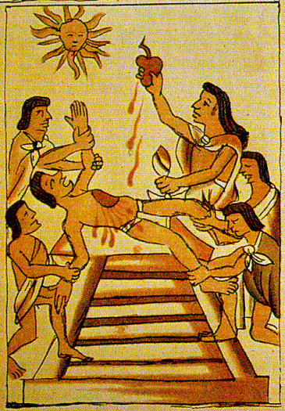
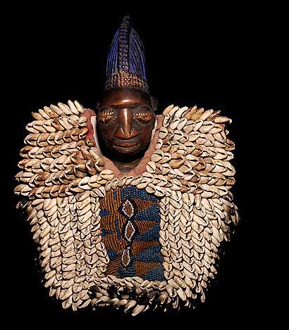
Primal Religions continued…

Slide 2
Totem Activity
Think of someone you respect, someone you can describe to me in detail.
Come up with as many “Descriptive words” you can for this person.
(I.e. Mr. Yumul- brave, Intelligent, handsome, caring, wise, well-aged, will be missed by all when he is gone but will appear in cloud form when needed)
Come up with a short bio why he/she is the person you respect.

Slide 3
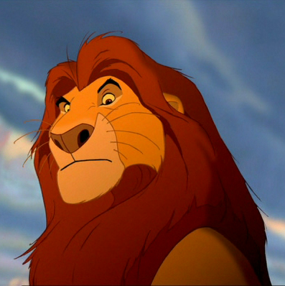
Totem continued…
Using the words you used, come up with a totem animal that best represents the person. Remember it can be Animal, Plant, object)
I.e. Mr. Yumul

Slide 4
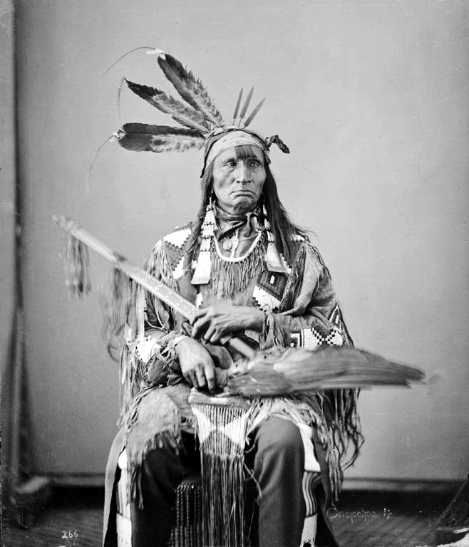
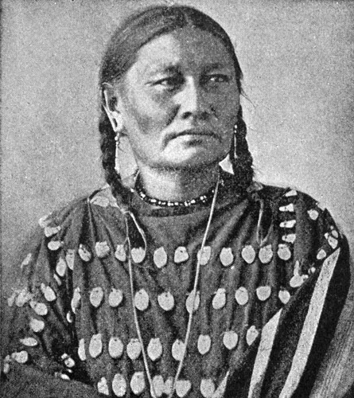
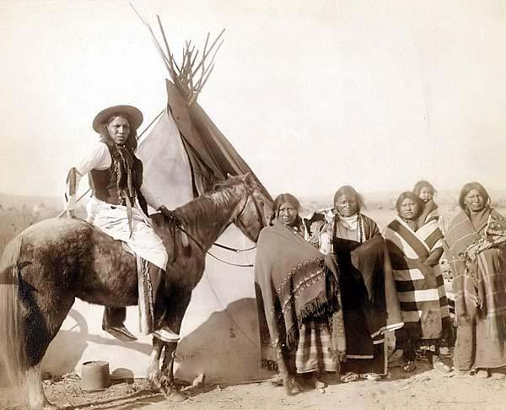
Religion of the North American Plains Indians

Slide 5
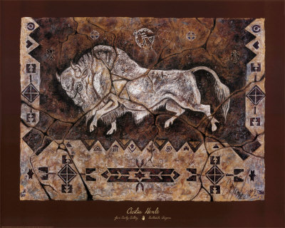
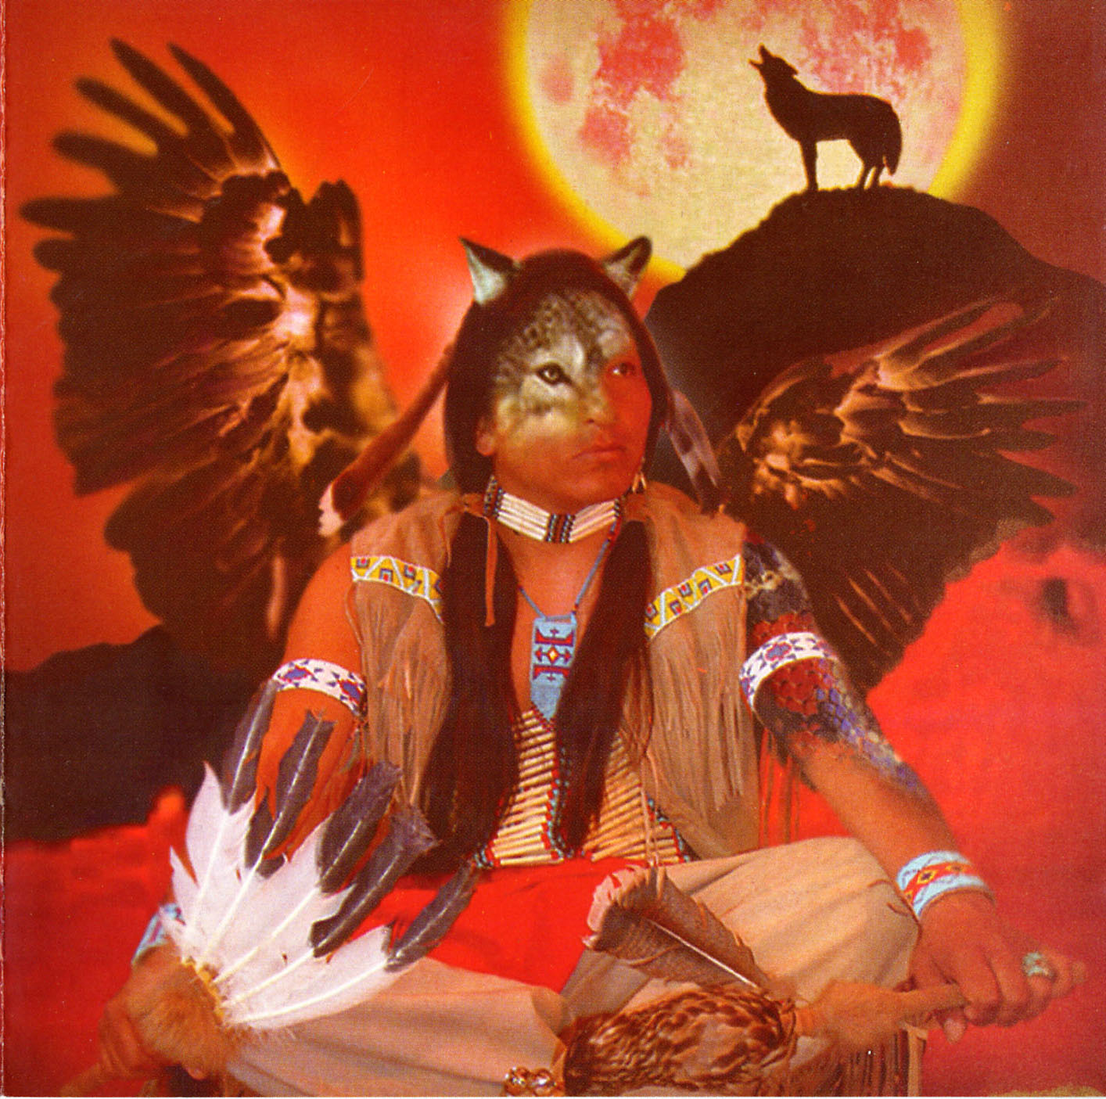
Spirit of Wakan Tanka
The Lakota name for the ultimate reality is Wakan Tanka
Translated as Great Spirit
16 spirits

Slide 6
Importance of number 4
16 spirits of Wakan tanka
4 X 4
4 directions of the compass

Slide 7
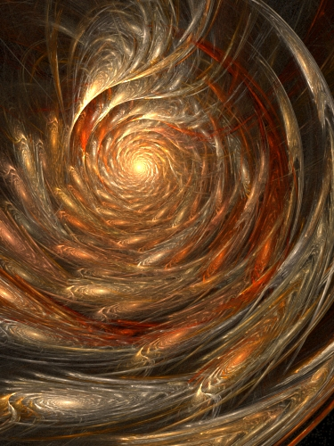
The Spirit path
4 spirits in each person
One eventually travels to the “spirit path” of the milky way.
Judged by an old woman

Slide 8
Creation Story
Sun and the Moon were married to each other
Old Man and Old Woman had a daughter Ite
Inktomi, the trickster, arranges an affair with the Sun and Ite
This causes the creation of time, space, and the earth.

Slide 9
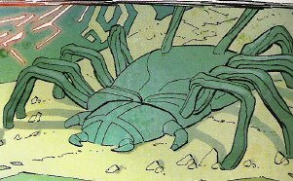
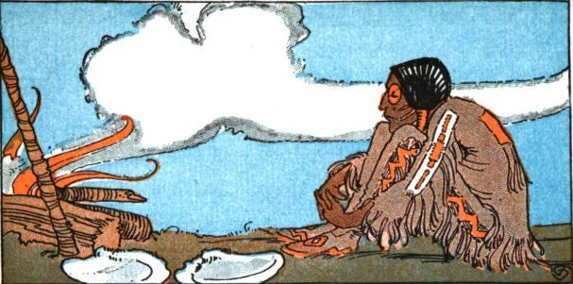
Inktomi – The Trickster
Inktomi tricks 7 humans and their families into going to Earth.
The earth turns out to be barren and inhospitable.

Slide 10
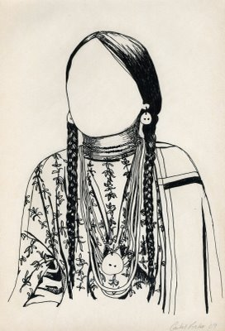
Wohpe ("Falling Star")
Takes pity on the humans
Presents them with a Sacred Pipe which can communicate with Wakan Tanka.
She teaches them 7 ceremonies

Slide 11
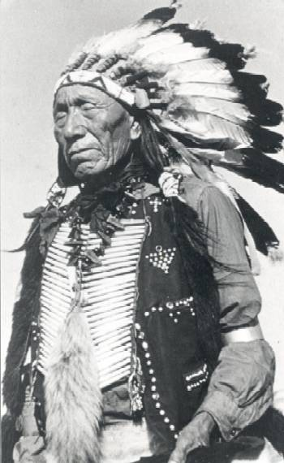
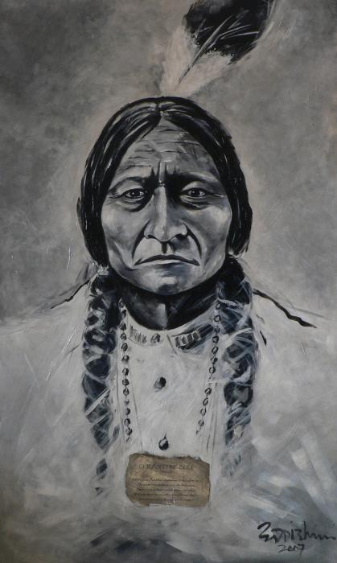
Medicine Man

Slide 12
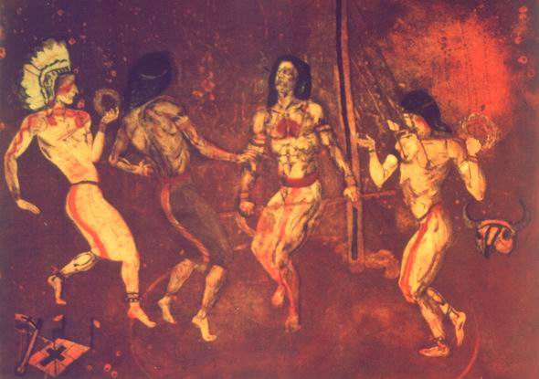
Lakota Sun dance
Led by Medicine Man or Woman
Creation of a lodge for the ceremony
Big cottonwood tree cut and put in the center
Represents Wakan Tanka
Also represents Axis Mundi

Slide 13
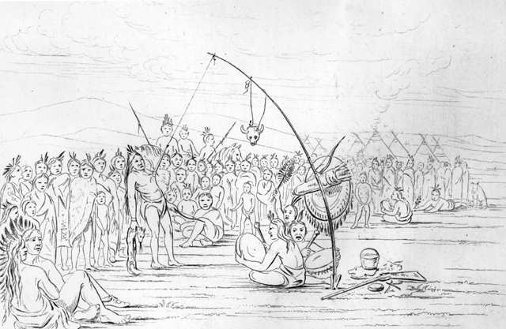
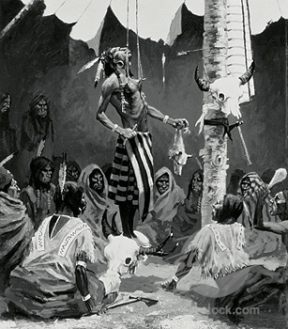
Sun Dance
The Lodge is a representation of the universe.
The Axis Mundi as the connection between spirit world and human world.
Their body is the only possession that really belongs to them.

Slide 14
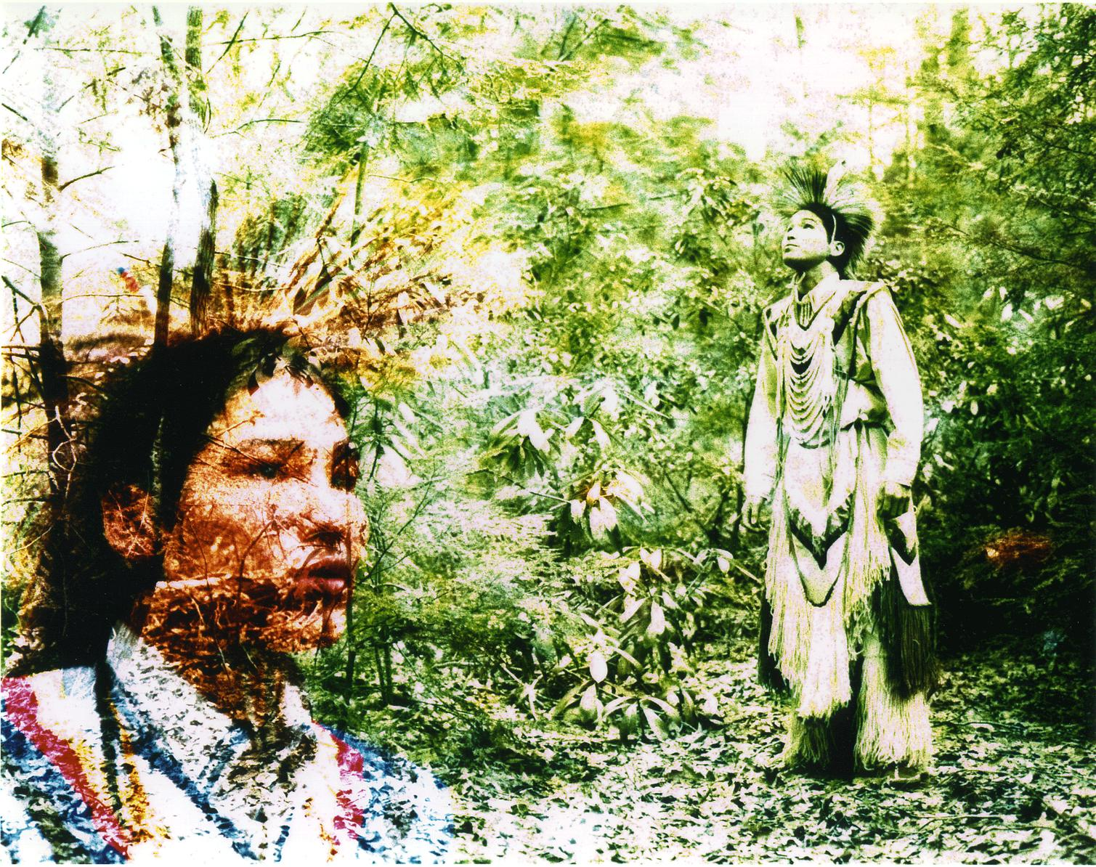
Vision Quest
Open books to pg. 30

Slide 15
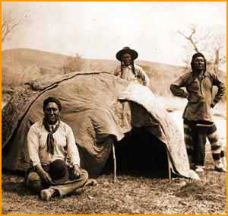
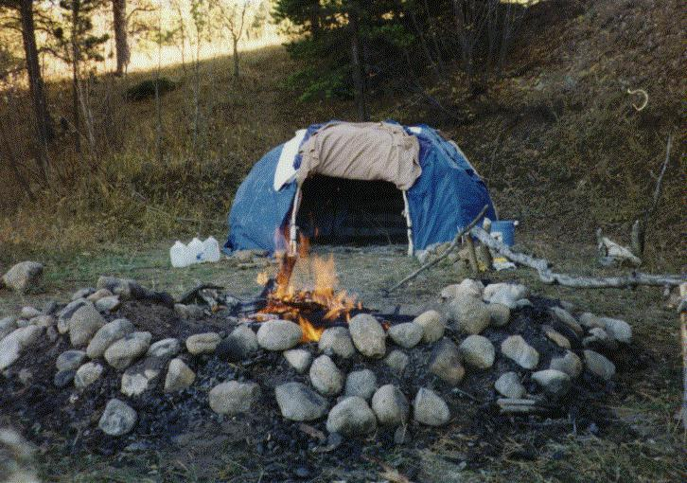
Sweat Lodge

Slide 16
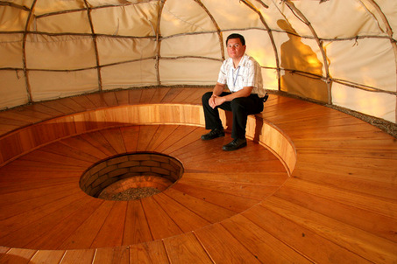
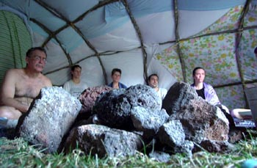
Sweat Lodge

