Slide 1
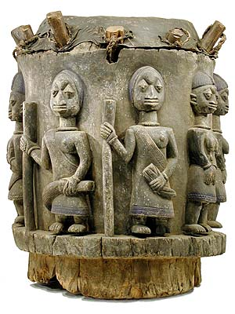
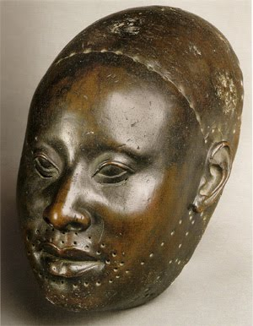
Religion of the Yoruba
Primal Religions

Slide 2
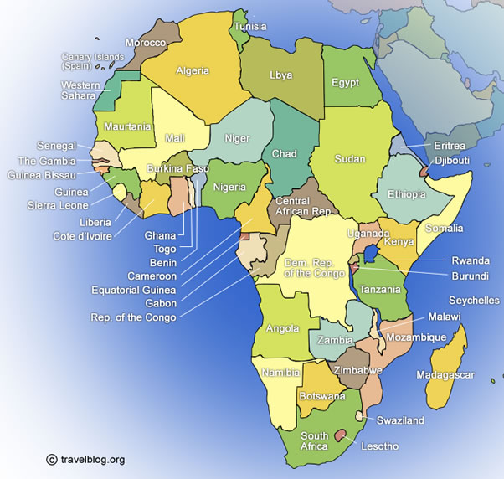
Africa
2nd Largest Continent
Nigeria, Benin, the Congo, Togo

Slide 3
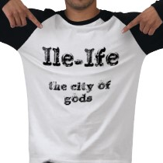
Yoruba
Not a nation, group with a common language
More than 10 million
Has been around 1,000 years
Most live in major cities independent from each other
Ife-center of Religion. It where creation first began

Slide 4
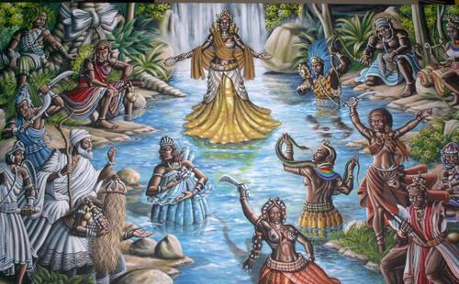
Olorun: the Supreme Being
Primary source of power. All life is the result of Olorun’s power.
Distant, not part of the world.
Prayers, but no shrines

Slide 5
Mediators to Olorun
Orishas: lesser dieties
All have power that can harm or benefit people depending on how they are worshiped.
Orisha-nla: creator of the earth
Ogun: God of Iron and War. Orginally the King of Ife.
Esu: Both good and evil. Mediates between heaven and hell. Translates for us to the Orishas. Trickster figure.

Slide 6
Ancestors of the living
Deceased humans who became deified
They possess powers just like the orishas and are worshipped.
2 types
Family ancestors who were good in life
An important person who is honored by many

Slide 7
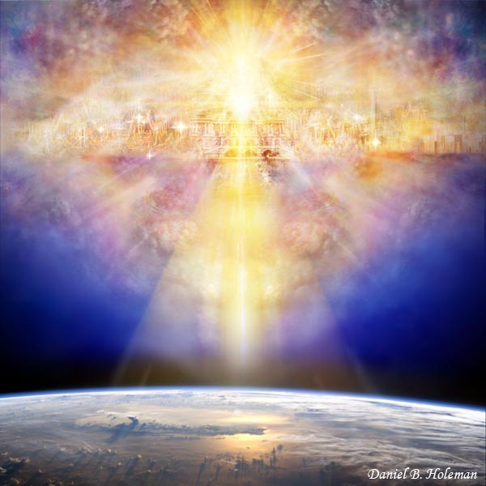
Yoruba Cosmology
Division between heaven and earth.
Heaven is invisible home of Orishas and the Ancestors
Earth is home of humans

Slide 8
2 types of Humans
Humans that are descended from the gods
“Perverted” human beings
Sorcerers and witches
Religion maintains the balance of heaven and earth
It also guards from the evil deeds of the witches and the sorcerers

Slide 9
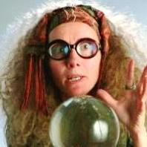
Mediating Heaven and the Earth
Different people between the heavens and the earth.
A specialist for each occasion
Diviners
Priests who practice the art of divination
It is believed that one must know their future before they can proceed with their lives

Slide 10
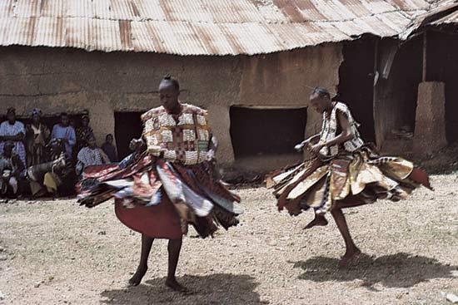
Taking on the spirits
Another type of specialist mediates between Ancestors and the living.
They put on masks and costumes and dance to represent those who have died.
They send messages from the dead to the living.

