Slide 1
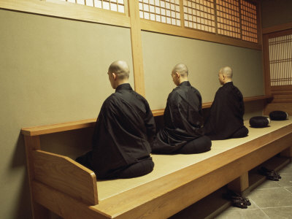
ZAZEN

Slide 2
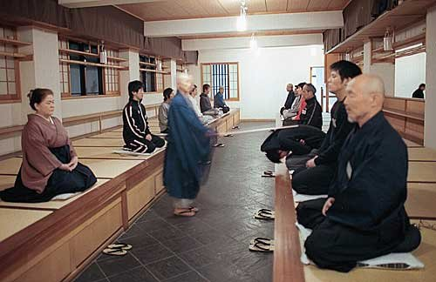
“Encouragement Stick”

Slide 3
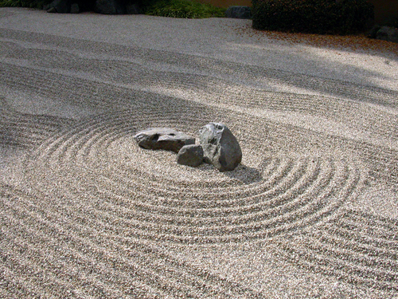
Zen Garden

Slide 4
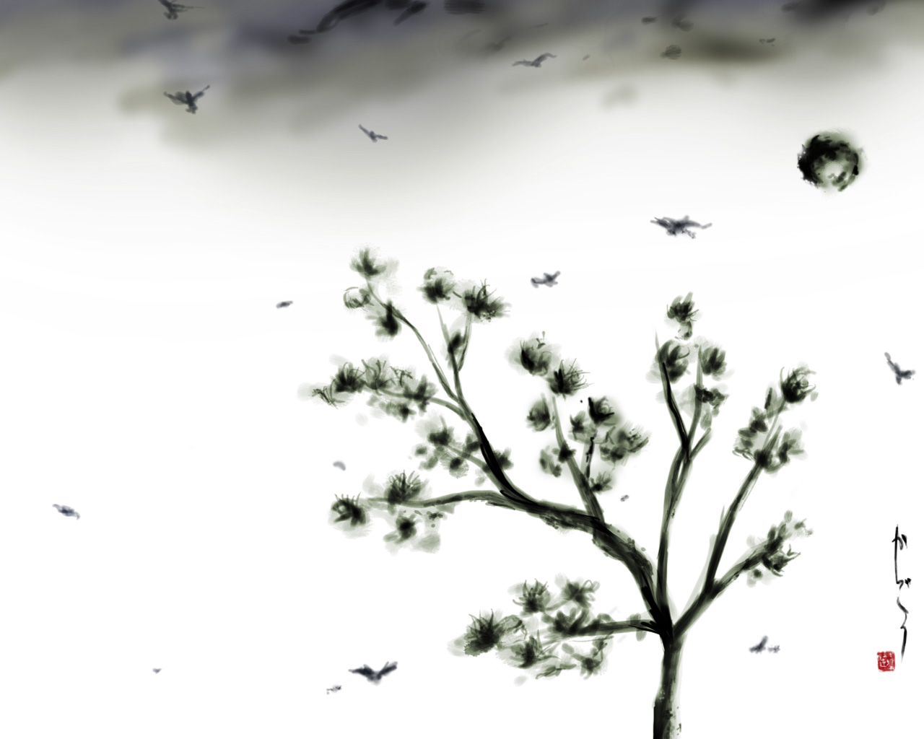
ZEN
Sumies

Slide 5
Blowing

Slide 6
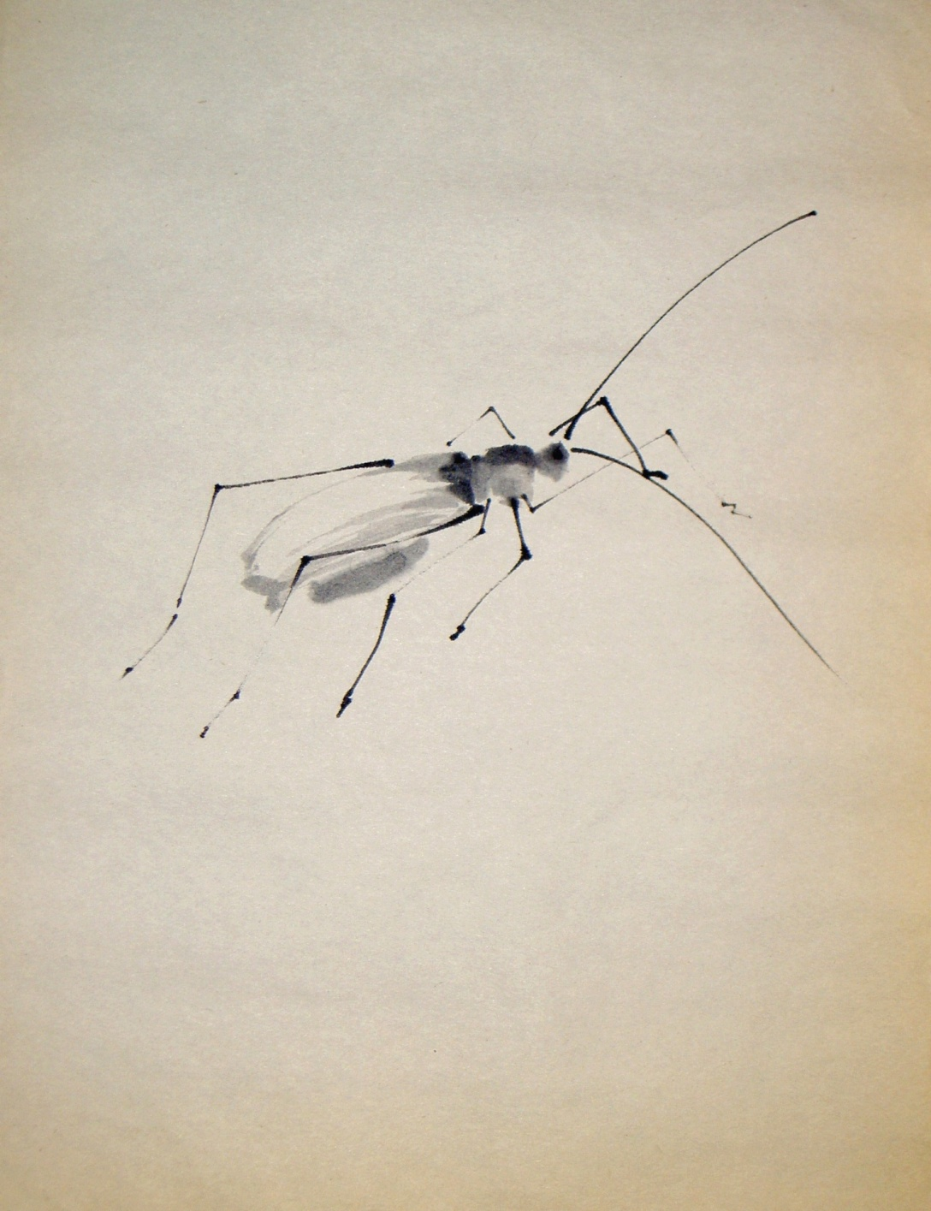
Pausing

Slide 7
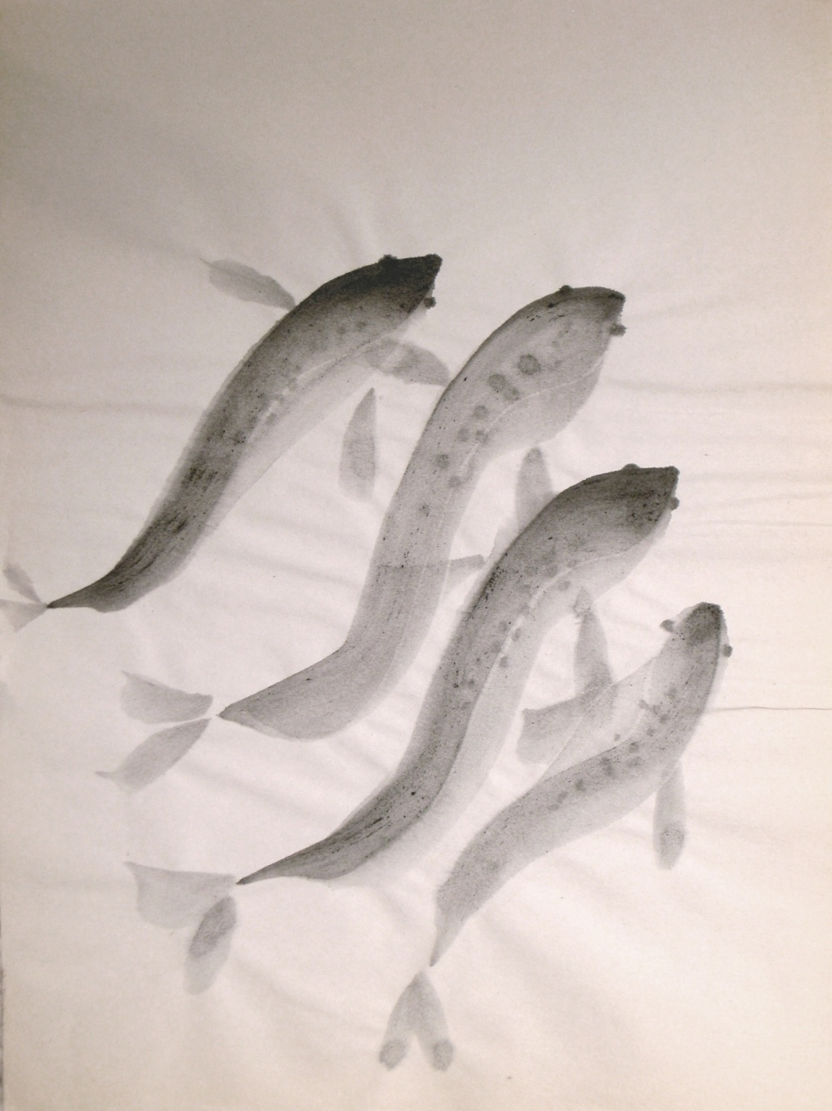
Gliding

Slide 8
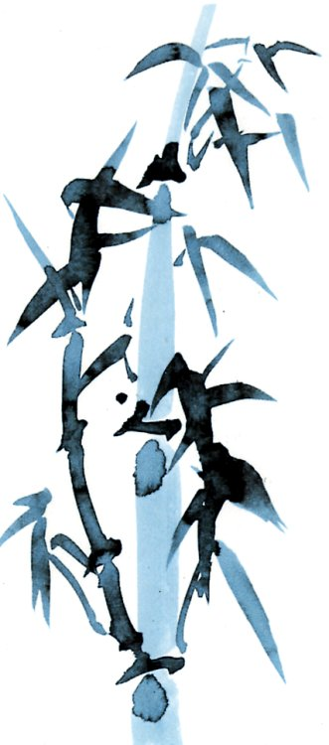
Strength

Slide 9
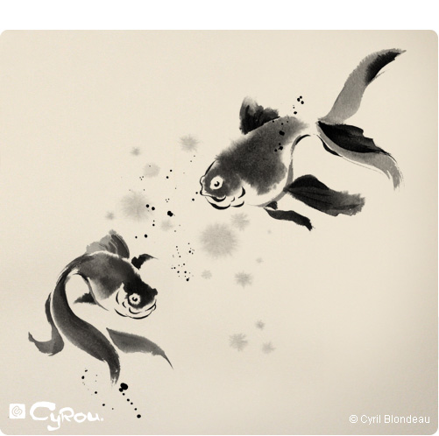
Haikus

Slide 10
I am so tiny The Universe so endless All my creation
The Old Pond;
A Frog Jumps in---
The sound of the water
One step A hundred crickets Jump
In plum-flower scent
Pop! The Sun Appears---
The mountain path
A day when Fuji
Is obscured by misty rain---
That’s interesting
How many, may things
They bring to mind---
Cherry Blossoms

Slide 11
